Slide 1



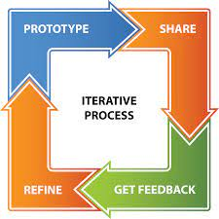

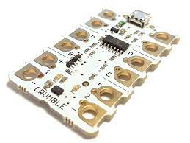
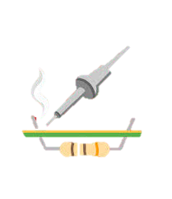

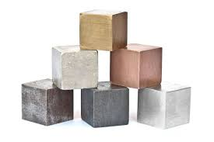





Sybil Andrews Academy
The best way to predict the future... is to create it.
KS3 Design Technology 2022/23
Learning journey
Year 10 GSCE Design & Technology (AQA)
Year 9 Electronics
Year 9 Systems & Control
Understanding electronics and building circuits. Electricity, Fossil fuels, Alternative energy, Electricity production, Electronic components, Circuits, PCB’s, Soldering, Integrated circuits, Build a timer circuit using a NE55 integrated circuit, Fault finding.
Building systems to control inputs and outputs through a PIC interface. Systems, Inputs, Outputs, Feedback, PICS, Coding a Crumble, LDR’s, LED’s, Sparkles.
Year 8 Metals
Year 8 Technical Drawing & CAD
Learn all about metals and use your CAD/CAM skills to make a small, metal cast key-fob. Sources, Types, Characteristics/properties, CAD/CAM, 2D Design, Design for manufacture, Pewter casting, Metal refining/finishing.
Developing skills and understanding of technical drawing techniques used to communicate design solutions. Equipment, Isometric, Orthographic, Perspective, Rendering, Thick & Thin line. Introduction to 3D CAD (Solidworks)
Year 7 Timber
Learn about the importance of timber and develop core workshop skills in the manufacture of a timber based product. Hardwood, softwood, manufactured boards. Material properties. Brief & Specification. Design and manufacture. Health & Safety. Core workshop skills using timber.
Year 7 CAD/CAM
Learn how to design using CAD. Design and manufacture a bookmark that is based on a favourite book and suitable for the intended user.
Design Brief, Specification, User needs, CAD/CAM, 2D Design (CAD), Designing for manufacture, Laser cutting (CAM)
Welcome to Design Technology!

