Slide 1
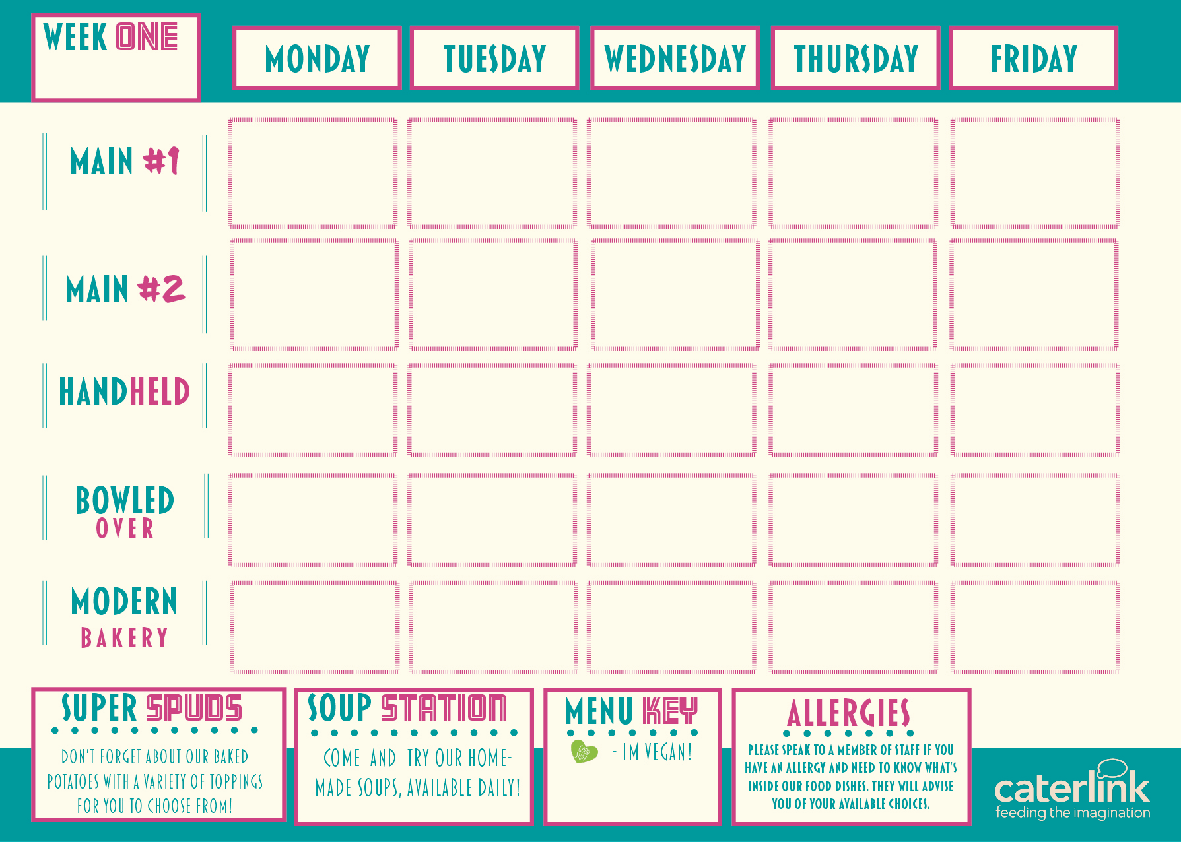







Macaroni Cheese with Roasted Veg or Crunchy Crouton Topping
NEW Chicken Katsu Curry with Noodles
Sausage & Mash
with Onion Gravy
Chicken Korma
with Rice &
Sambals
Battered Fillet of Fish served with Chips, Peas & Tartare Sauce
Roasted Vegetable Stir Fry with Noodles
NEW Feta & Spinach Quiche with Chips & Peas
Vegetarian Spaghetti Bolognese with Garlic Bread & Salad
Veggie Sausage
& Mash with
Onion Gravy
Sweet Potato, Chickpea & Spinach Tikka with Rice & Sambals
Hot Filled Baguette
Chicken Wrap
Cheese & Onion Panini
Jumbo Hotdog
Pepperoni Pizza
Loaded Nachos
Herby Tomato Pasta
Loaded Wedges
Street Chicken Noodles
Tomato Meatball Pasta
Lemon Drizzle Sponge
Blondie with Berries
Apple & Cherry Oaty Crumble with Custard
Fruit Muffin
Chocolate & Banana Sponge

Slide 2




Vegan Cottage Pie with Broccoli, Peas & Gravy
Peri Peri Chicken Sub with Super Grains and Slaw
Roast Gammon, Roast Potatoes, Seasonal Vegetables & Gravy
Chicken Tikka Masala served with Rice & Sambals
Salmon Fishcakes
with Chips & Peas
Roasted Potato & Winter Veg Medley with Broccoli, Peas & Gravy
Potato Layer Bake with Roast Potatoes, Seasonal Vegetables & Gravy
Vegetable Korma
served with Rice &
Sambals
Roasted Chickpea and Bean Pitta with Super Grains and Slaw
Posh Dog with
Tater Tots
Half Cheese & Tomato Bagel
Authentic Pizza Slice
Hot Filled Baguette
Cheese & Tomato Panini
Chicken Folded Naan
Herby Tomato Pasta
Vegetable Chilli & Rice
Sweet Chilli Noodles
Loaded Nachos
Cheesy Pasta
Cinnamon Apple Turnover
Syrup Sponge
Plum Crumble with Custard
Vanilla Sponge
Carrot Cake

Slide 3



Spaghetti & Meatballs with Garlic Bread
Chicken Pie with Roasted New Potatoes, Broccoli & Gravy
Breaded Fish Fingers with Chips, Peas or Beans, & Tartare Sauce
Beef Chilli with Rice or Soft Tacos
Lemon & Herb Chicken with Flatbread & Salads
Cheese & Potato Pinwheel with Jacket Wedges & Beans
Vegetarian Wellington with Roast Potatoes, Broccoli & Gravy
Bean Burger with
Chips & Peas
Mexican Vegetables with Rice or Soft Tacos
Houmous & Falafel Flatbread with Salads
BBQ Chicken Wrap
Chicken Burger
Tomato & Cheese Panini
Authentic Pizza Slice
Hot Filled Baguette
Noodle Bowl
Loaded Nachos
Sausage & Chips
Rice Bowl
Tomato & Mascarpone Pasta
Warm Banana Flapjack
School Cake
Chocolate Shortbread Cake
Sticky Toffee Apple Crumble with Custard
Pancakes & Cherry Sauce

