Slide 1
Year 11 Parents Information Evening
Preparation for GCSE’s
Notes:
NHo

Slide 2
Aims of the Evening
Below are the areas that we are going to cover during this evening's event:
Revisiting our last information evening
Structure of the school day during exams (Inc. revision booster sessions and study leave)
Revision sessions (After school and Easter)
French Speaking Exams and other pre-GCSE window exams
Exam protocols/regulations
Post GCSE plans (Leavers Day and Prom)
GCSE Maths Update (Mrs Wilson)
What are the next steps?
Notes:
NHo

Slide 3
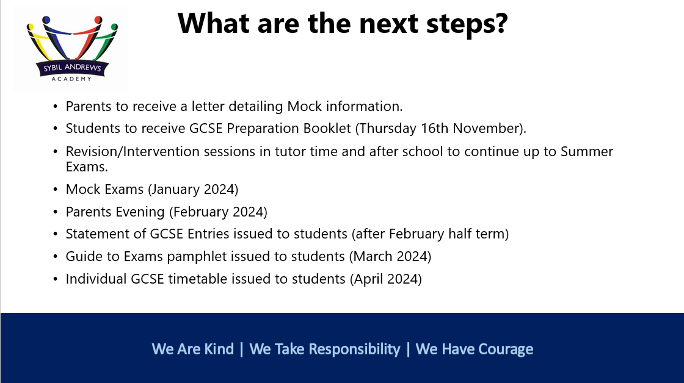
Revisiting our last Information Evening
What has been done since the last time we met?
Students have sat and received grades and feedback on their mock exams (January/February)
Parents Evening (February)
Students have received their statement of entries and JCQ guidance booklets (March)
Revision and intervention sessions during tutor time and after school have continued.
Notes:
NHo

Slide 4
Structure of the school day during exams
The school will not be operating study leave, this means students will be expected in school until the end of their exams. The school day will look as outlined below:
Morning exams will start at 9:30, this means students will have a 40-minute revision booster session on the morning of their exam between 8:40-9:20. Cereal bars will be provided during these sessions.
Afternoon exams will begin at 13:30, this means some exams may run beyond 15:00, so if students are on school buses, alternative transport may need to be arranged.
For some exams, students may have afternoon revision booster sessions the day before, if they do not have an afternoon exam.
For the rest of the day, students will be expected to attend lessons as normal and complete independent revision.
Notes:
AKi

Slide 5
Revision sessions
We are continuing to run after school revision sessions (which are very well attended!).
We will also be running Easter revision sessions – please see the timetable.
Notes:
AKi

Slide 6
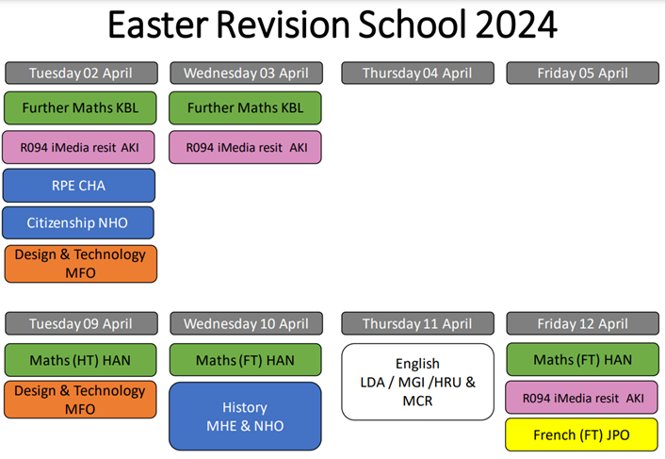
Notes:
AKi

Slide 7
French Speaking and other pre-GCSE exams
Well done to everyone involved in the Hospitality and Catering practical!
French Speaking Exams – Thursday 18th April-Wednesday 24th April (schedule to be shared with students before Easter)
Art – Thursday 25th April and Friday 26th April
PE Practical Moderation – Tuesday 30th April
Notes:
NHo

Slide 8
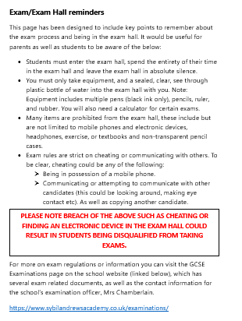
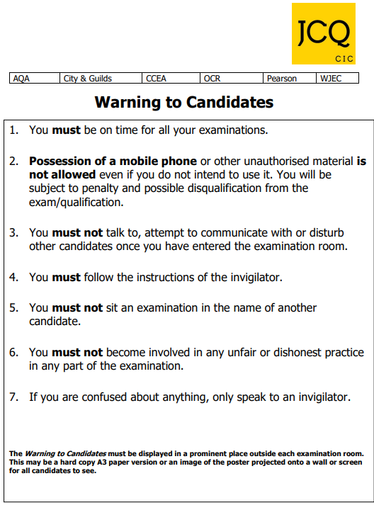

Exams - Protocols and Regulations
Notes:
AKi

Slide 9

Year 11 Maths
Notes:
JWi

Slide 10
Key Dates
GCSE Paper 1 ( non-calculator) | Thursday 16th May
GCSE Paper 2 (calculator) | Monday 3rd June
GCSE Paper 3 (calculator) | Monday 10th June
Statistics Paper 1 (calculator) | Wednesday 5th June
Statistics Paper 2 (calculator) | Monday 17th June
Notes:
JWi

Slide 11
What we have been doing in class
Pupils have been completing:
1 mark questions
Exam papers
QLAs
Working on exemplar material
Walking, talking mock
What we have been doing:
Rewarding homework completion & completed exam papers
Given examiners' feedback
Have past papers on hand for pupils to complete
Notes:
JWi

Slide 12
What our pupils can do to revise
Complete their Sparx Maths homework
Using Sparx to fill the gaps in knowledge
Complete past papers
Use online resources: Maths Genie, Dr Frost Maths, OnMaths
Notes:
JWi

Slide 13
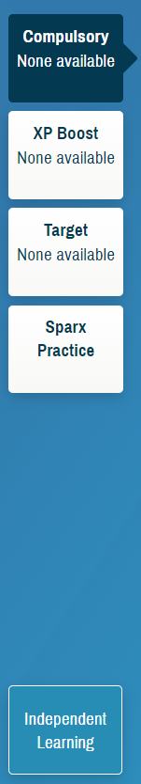
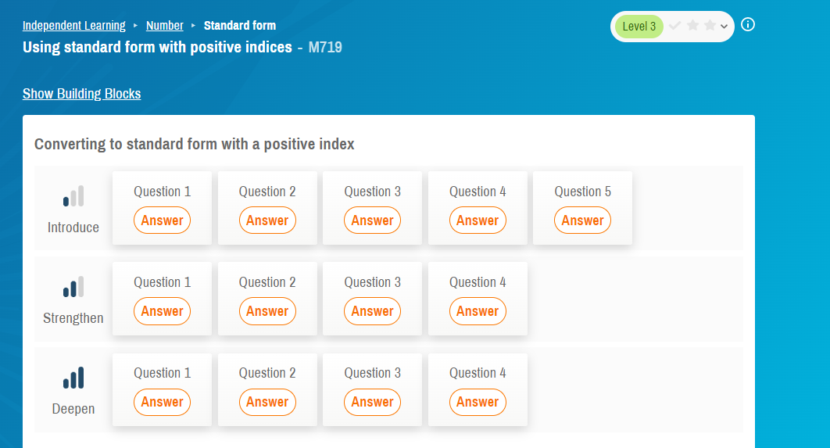
Homework
Notes:
JWi

Slide 14
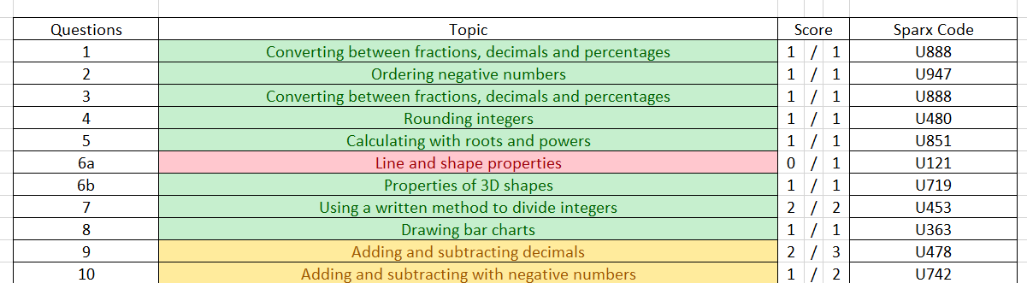
Filling gaps
Notes:
JWi

Slide 15
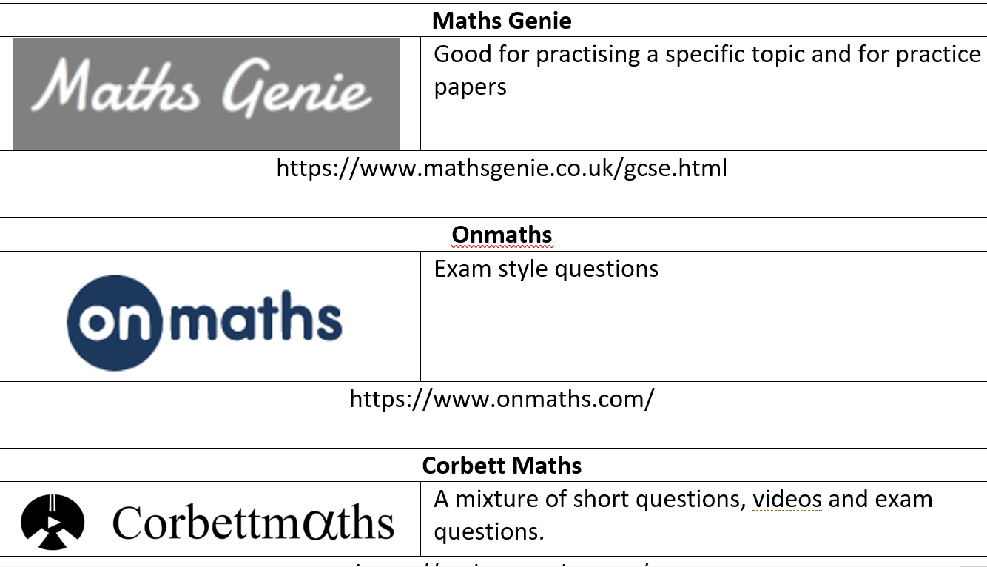
Websites
Notes:
JWi

Slide 16
Maths Intervention Sessions
Foundation & Higher Tier:
Wednesdays: 3:45pm – 4:45pm
Higher Tier: Thursdays online 4.30pm-5.30pm
Notes:
JWi

Slide 17
Maths Intervention Sessions
Date | Grade 4/5 | Grade 8/9
24th April | Everything to do with fractions | Histograms
1st May | English
8th May | Averages from tables/diagrams | Equations of lines and perpendicular lines Upper and lower bounds
15th May | English
22nd May | Problem solving | Box plots
Notes:
JWi

Slide 18
Post GCSE Plans
Leavers Day (Periods 3 and 4 on Thursday 20th June)
Prom (Wednesday 10th July) – Letters regarding tickets coming out this week.
    Key Dates – Deposit payment (£20) = 29th April, final payment (£29) = 31st May
    Passport to Prom
GCSE Results Day (Thursday 22nd August)
Please note, students need to be available up to and including Wednesday 26th June as this is a contingency day!
Notes:
NHo

Slide 19
What are the next steps?
Easter Holiday revision sessions
Individual GCSE timetable issued to students (April)
GCSE exams to begin (April/May)
Leavers Day (June)
Prom (July)
GCSE results day (August)
Notes:
NHo

Slide 20
Thank you for attending this evening. We hope this has been useful and hugely appreciate your engagement and support.
Please do feel free to speak with a member of staff if you have any questions.
Notes:
NHo

