Slide 1
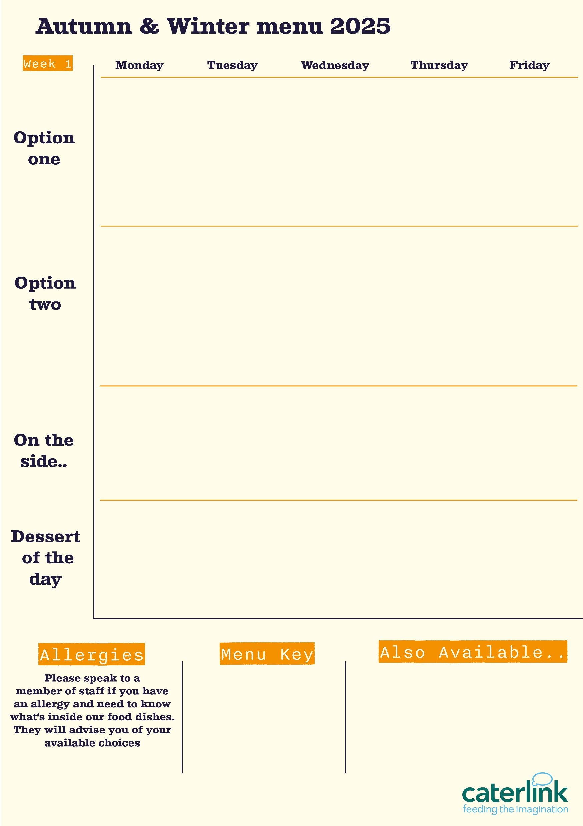
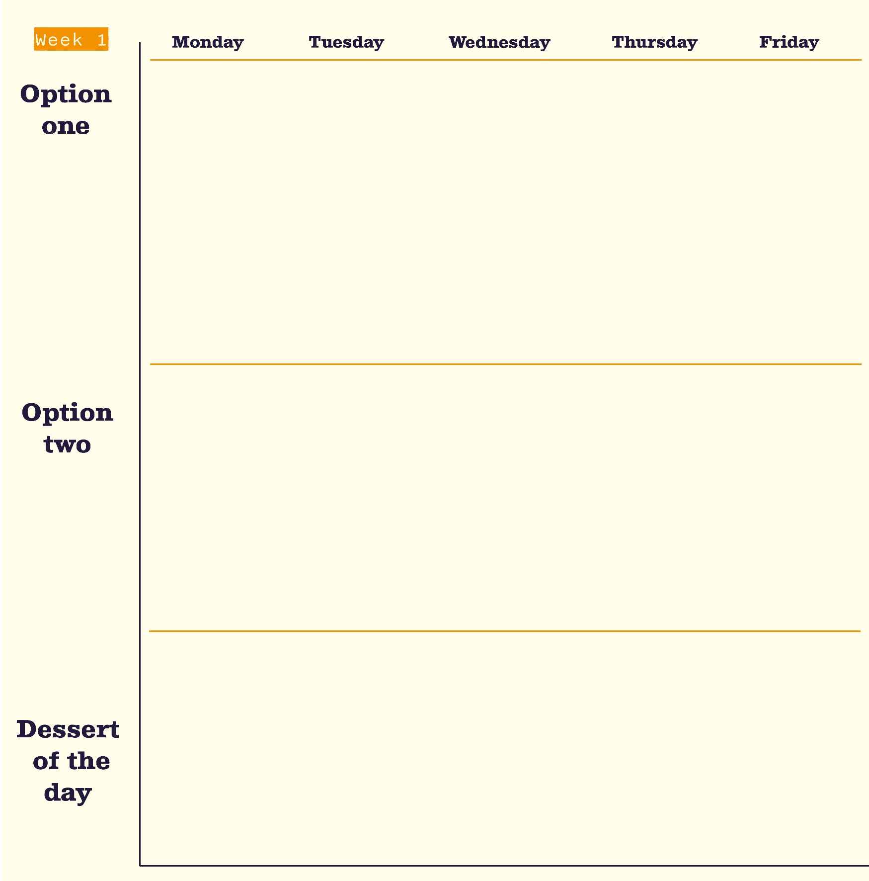




Spring Summer Menu 2026
Smokey Beef Chilli Tacos and Wedges
with Fresh Tomato, Pineapple and Cucumber Salsas
Classic Beef Lasagne
with Garlic Bread and Chunky Roasted Summer Veg
Spicy Chicken Flatbread
with Spicy Rice and Rainbow Slaw
Fillet of Fish or Butchers Sausage
with Chips, Peas and Tomato Sauce
Chicken
Tikka Masala
with Rice & Sambals
Butternut & Feta Quesadilla and Wedges
with Fresh Tomato, Pineapple and Cucumber Salsas
Veggie Bolognaise
with Garlic Bread and Chunky Roasted Summer Veg
Cheese & Tomato Quiche
with Chips, Peas and Tomato Sauce
Smokey Bean Burger
with Spicy Rice and Rainbow Slaw
Sweet Potato & Chickpea Curry
with Rice & Sambals
Sticky Toffee Apple Crumble
with Custard
Pineapple Upside Down Cake
Chocolate Brownie
Jam & Coconut Sponge
Oaty Flapjack
Vegan option
Our hot and cold grab & go selection alongside filled baguettes / sandwiches and filled jacket potatoes
Added plant protein
Source of wholemeal

Slide 2



Spring Summer Menu 2026
Roast of the Day
with Roasted Potatoes, Yorkshire Pudding, Seasonal Veg & Gravy
BBQ Pulled Pork Slider
with Paprika Wedges and Slaw
Battered Fish or Salmon Fishcake
and Chips with Garden Peas
Chicken Souvlaki
with Seasoned Potatoes, Tzatziki and Greek Salad
Mac and Cheese with Toppings
Croutons, Pepperoni Pieces, Crispy Onions, Spring Onions, Barbecue Beans
Roasted Quorn Fillet
with Roasted Potatoes, Yorkshire Pudding, Seasonal Veg & Gravy
Burrito Bowl
with Rice, Charred Corn Salad, Salsa and
Sour Cream
Summer Broccoli and Feta Quiche
with Summer Salad and Chips
Feta & Spinach Parcel
With Seasoned Potatoes, Tzatziki and Greek Salad
Chocolate Orange Cookie
Cherry Apple Crumble
with Custard
Fruit
Muffins
Peach Upside Down Cake
with Custard
Chocolate Swirl
Vegan option
Our hot and cold grab & go selection alongside filled baguettes / sandwiches and filled jacket potatoes
Added plant protein
Source of wholemeal

