Slide 1
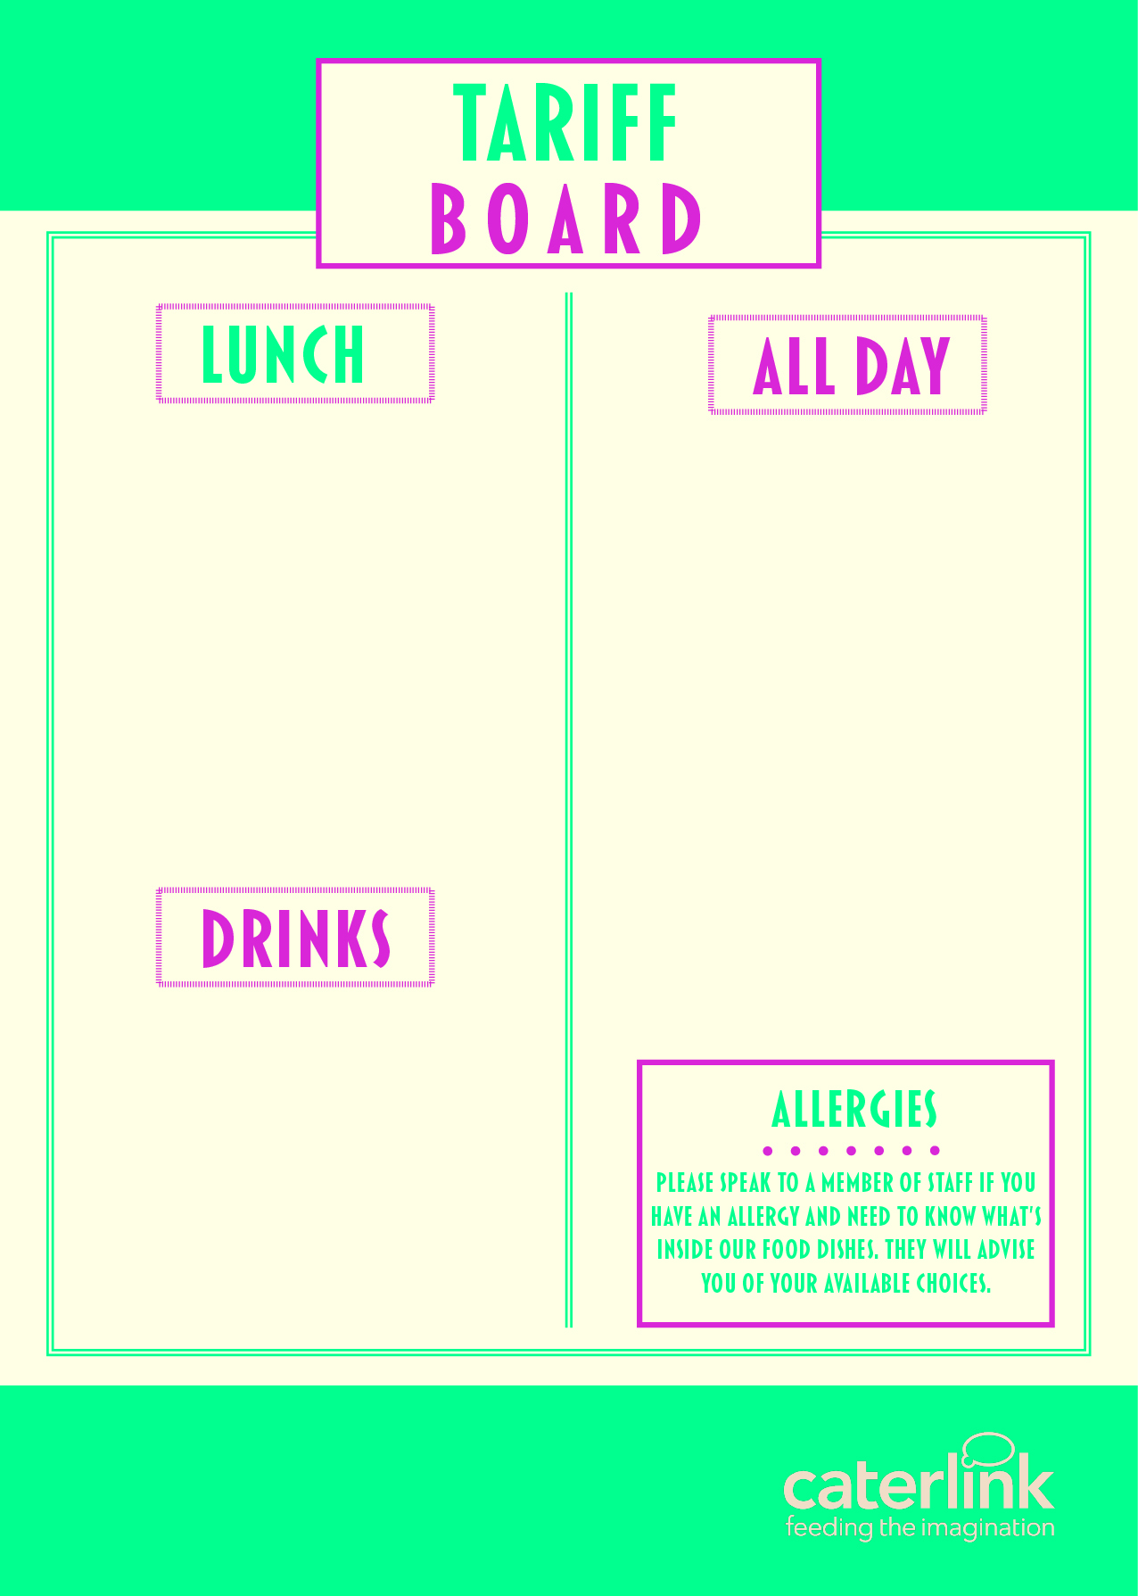
MEAL DEAL | £2.90
PIZZA SLICE | £1.90
JACKET POTATO & 2 FILLINGG | £2.60
PASTA, SAUCE & CHEESE | £2.60
PANINI (2 FILLINGS) | £2.70
CAKE / HOMEBAKE / COOKIE | £1.20
SANDWICHES / BAGUETTES FROM | £2.00
FRUIT POTS | £1.20 / £1.60
WRAPS FROM | £2.35
SALAD POTS FROM | £1.90
CHIPS / WEDGES | £1.69
SAUSAGE ROLLS | £1.69
HOT FILLED ROLLS FROM | £2.43
CROISSANT | £1.63
PAIN AU CHOCOLAT | £1.63
BEEF / CHICKEN BURGER | £2.64
WATER | £1.10
RADNOR FIZZ | £1.47
RADNOR SPLASH | £1.47
JUICE CARTONS | £1.17
(OTHER DRINKS AVAILABLE FROM | £1.00

