Slide 1
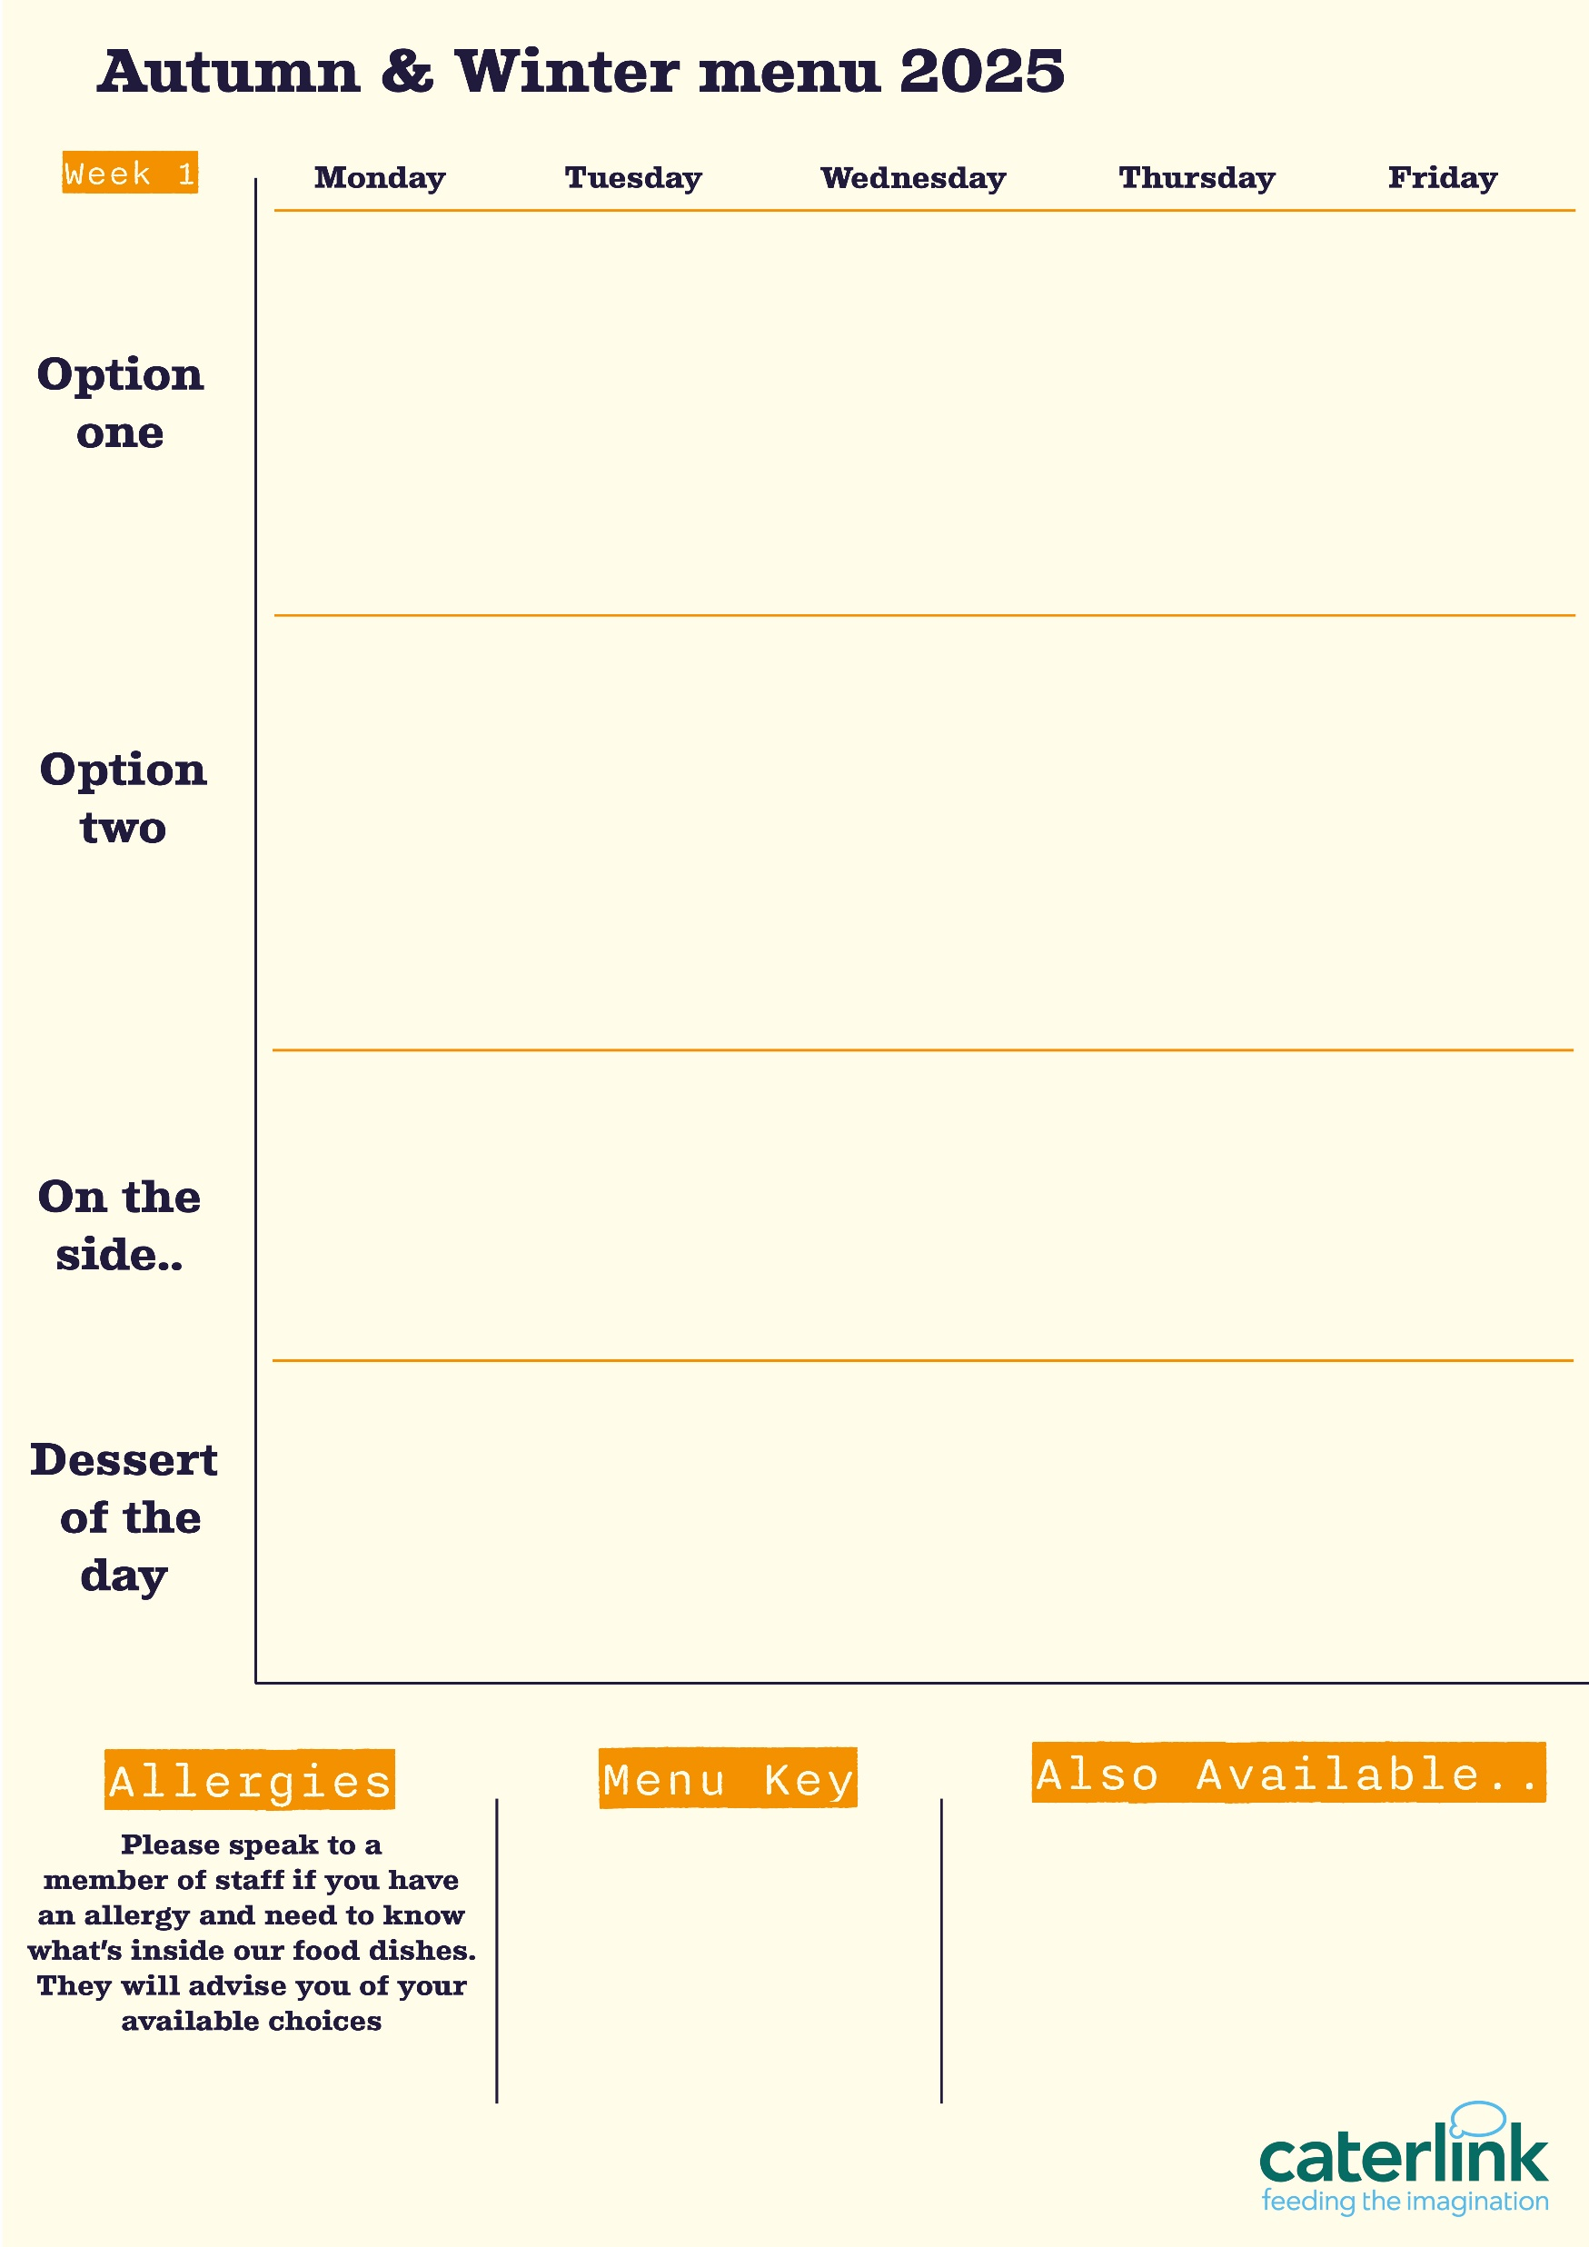
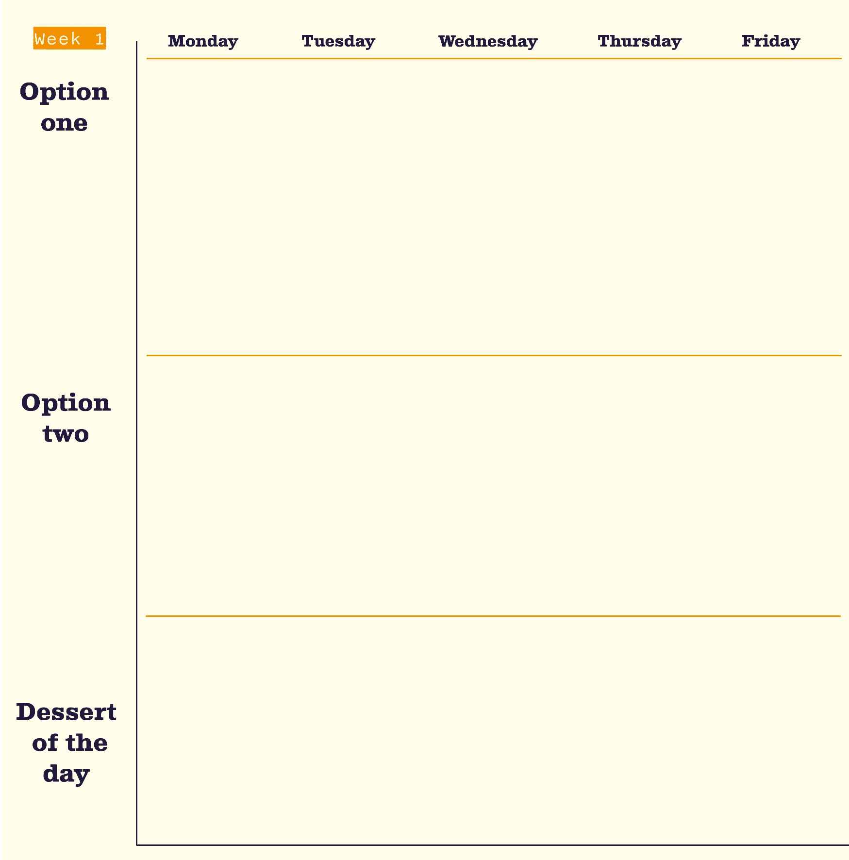








Autumn Winter Menu 2026
Lemon & Garlic Chicken
Roast of
the Day
Served with all the traditional trimmings
Battered
Pollock or Jumbo Sausage
with Chips &
Baked Beans
Chicken Korma
with Basmati Rice & Naan Bread
with Kobez Bread, Fresh Salad & Yoghurt Dip
Served with Croutons, Pepperoni Pieces, Crispy Onions, Spring Onions or Barbecue Beans
Sweet Chilli Noodles
with Vegetable Spring Roll
Garden Vegetable Cottage Pie
with Carrots &
Gravy
Sweet Potato, Chickpea & Spinach Tikka
with Rice & Naan Bread
Chip Shop Style Veggie Burger
with Chips & Peas
Cheesecake of the Day
Apple Crumble Slice
Chocolate Marble Cake
Millionaire Shortbread
White Chocolate Cookie
Vegan option
Our hot and cold grab & go selection alongside daily pastas and filled jacket potatoes
Added plant protein
Source of wholemeal

Slide 2





Autumn Winter Menu 2026
Original Spice Chicken Thigh
with Sweet Potato Fries & Sweetcorn Salsa
Beef Chilli Tacos
with Wholemeal Rice & Cucumber Salsa
Battered
Pollock or Jumbo Sausage
with Chips &
Baked Beans
Butchers Sausage & Mash
with Onion Gravy & Seasonal Veg
Italian Classics Day
A selection of Homemade Pizzas, Pasta Dishes, Garlic Bread & Fresh Salads
Vegetable Spring Rolls
with Chips & Curry Sauce
Smokey Quorn
Burger
with Sweet Potato Fries & Sweetcorn Salsa
Plant Sausage & Mash
with Onion Gravy & Seasonal Veg
Smokey Soya Chilli
with Wholemeal
Rice & Tomato Salsa
Rice Krispie Cakes
Classic Cornflake Tart
Jam & Coconut Sponge
School Cake
Chocolate Brownie
Vegan option
Our hot and cold grab & go selection alongside daily pastas and filled jacket potatoes
Added plant protein
Source of wholemeal

