Slide 1
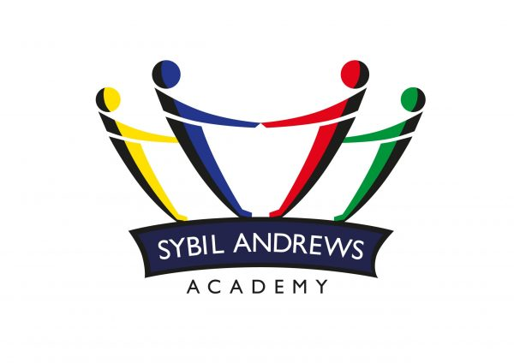

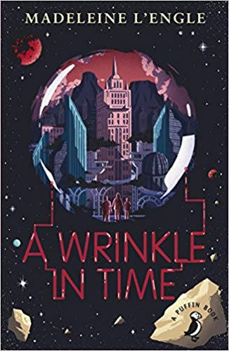
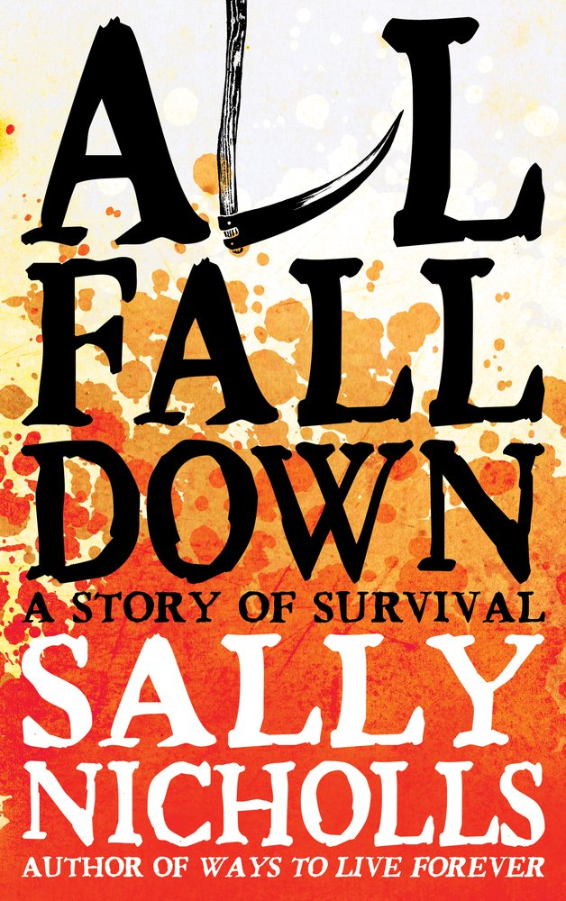
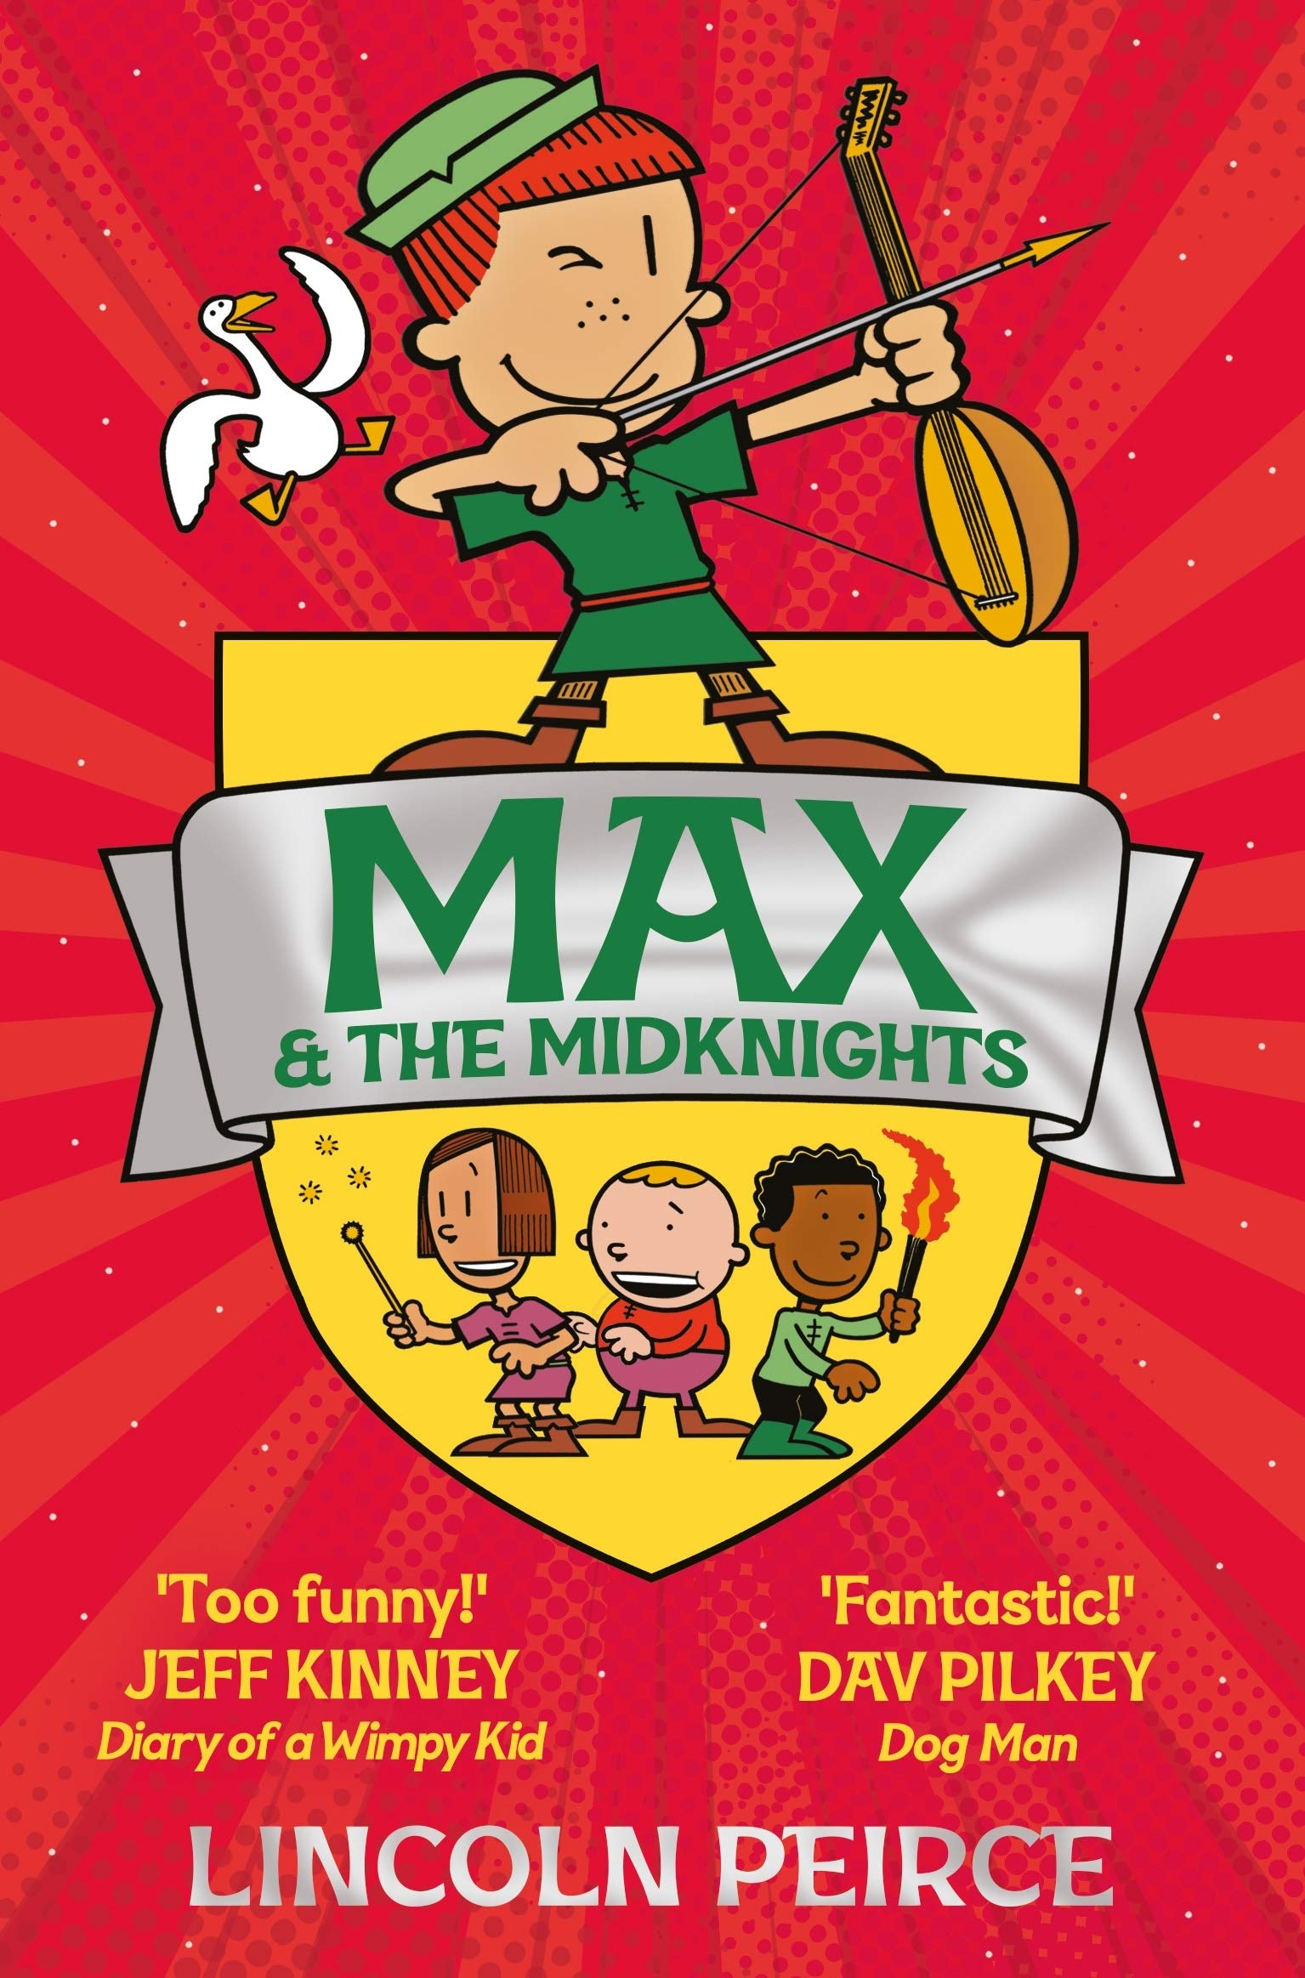
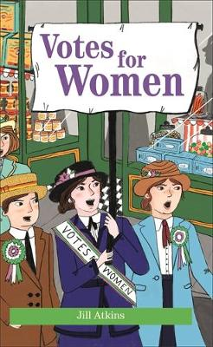
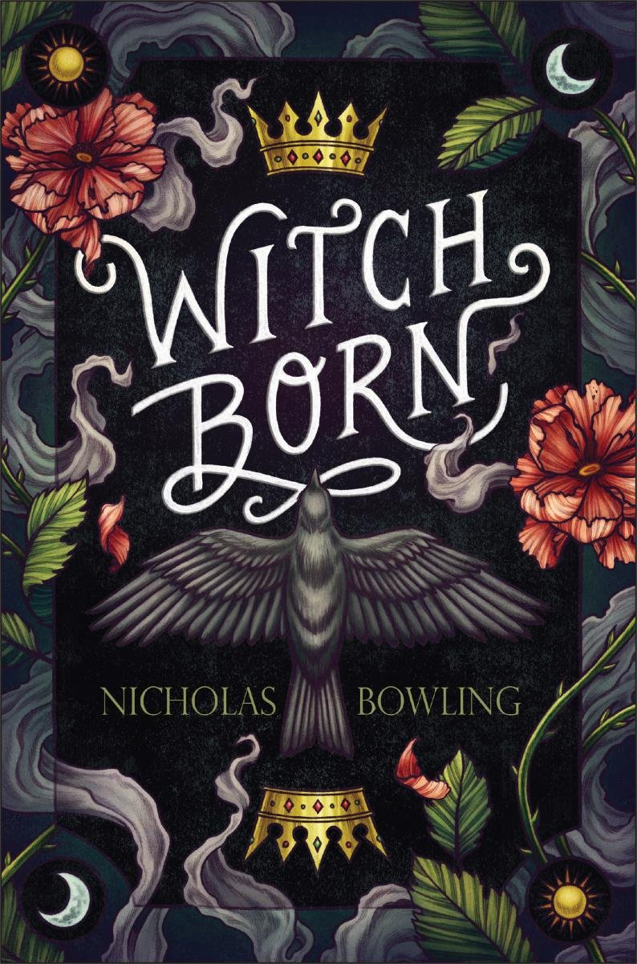
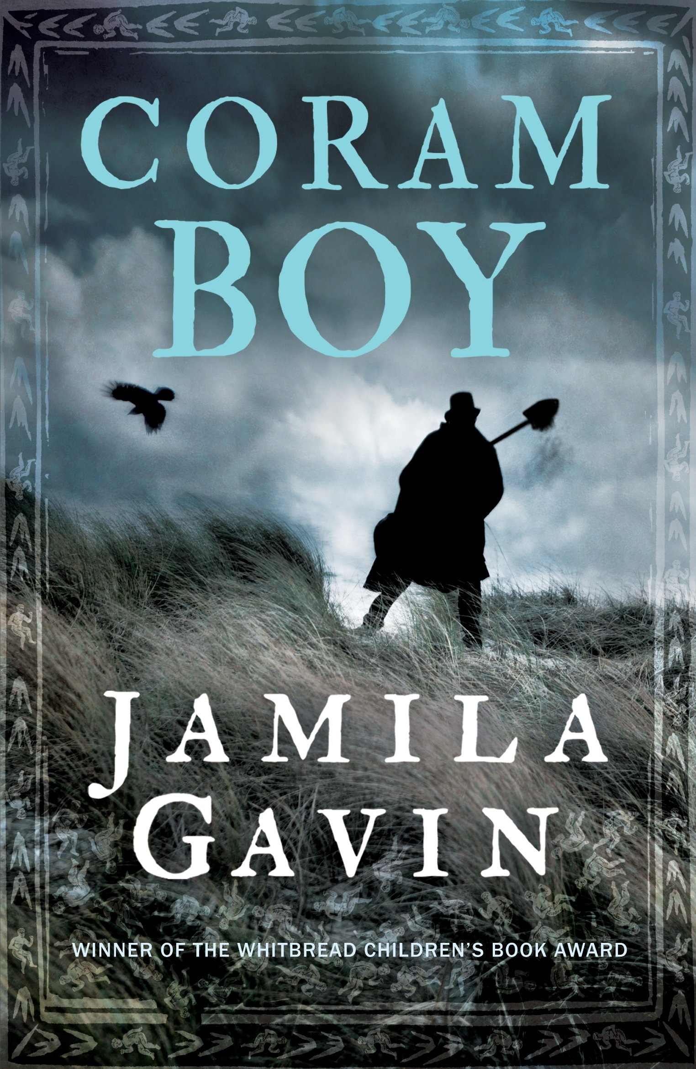
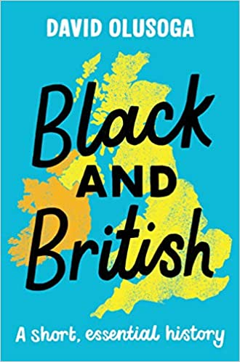
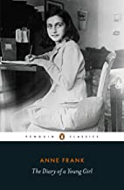
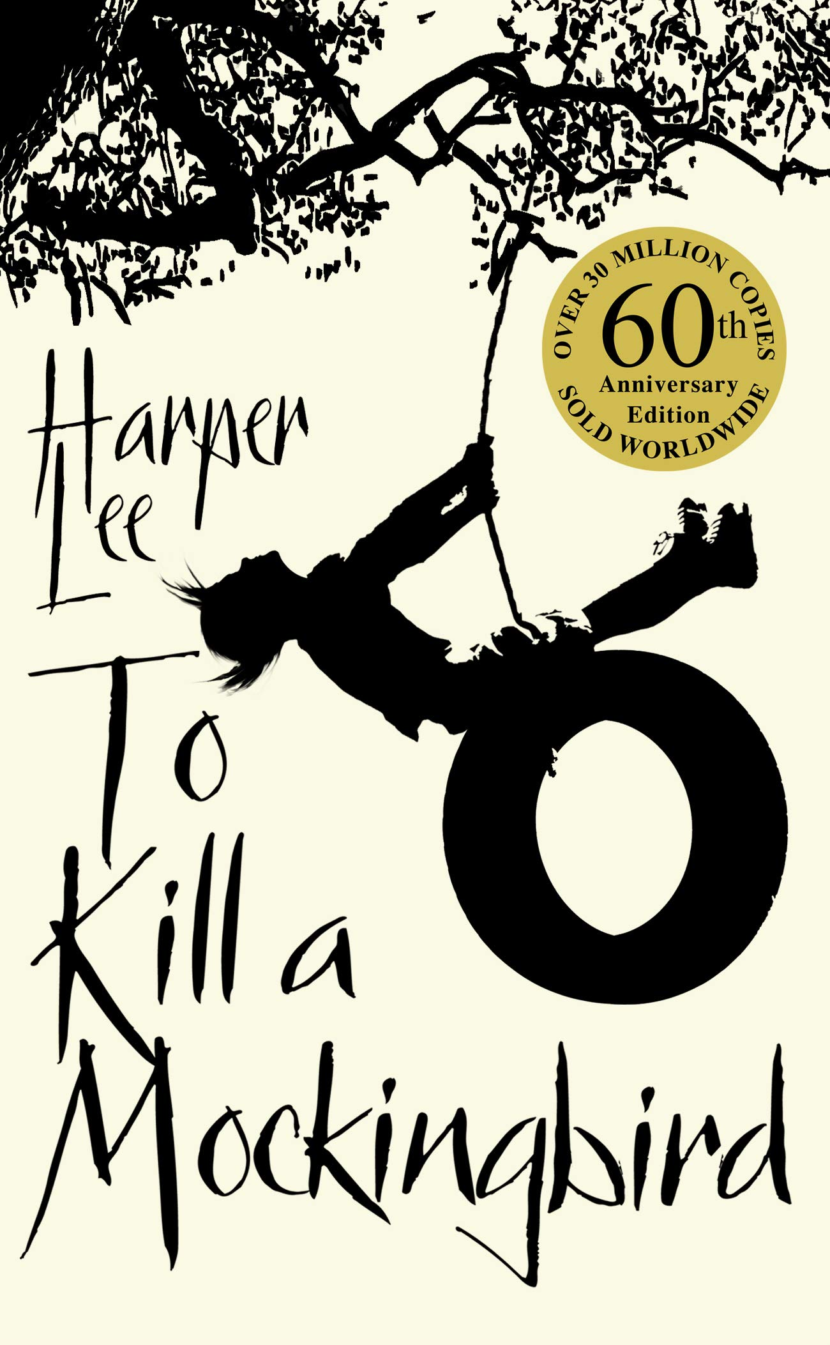
Sybil READS – KS3 Reading List
History
L'Engle, Madeleine, A Wrinkle in Time
Adventures in space and time of Meg, Charles Wallace, and Calvin O'Keefe. They are in search of Meg's father, a scientist who disappeared while engaged in secret work for the government on the tesseract problem.
Sally Nicholls, All Fall Down
A deadly contagion races through England... Isabel and her family have nowhere to run from a disease that has killed half of Europe. When the world she knows and loves ends for ever, her only weapon is courage..
Lincoln Peirce, Max and the Midknights
Max wants to be a knight - too bad that dream is about as likely as finding a friendly dragon.
But when Max's uncle Budrick is kidnapped by the cruel King Gastley, Max has to act . . .and fast!
Home Region & Map Skills
Jill Atkins, Votes for Women
Alice and Rose are sisters growing up in the early years of the 20th century. Sixteen-year-old Alice thinks there is no more important issue to campaign for than ensuring women get the right to vote, but Rose is more uncertain.
Nicholas Bowling, Witchborn
It's 1577, when her mother is burned at the stake for witchcraft. Alyce flees to London, but it isn't just witchfinders she has to worry about as she is dragged her into the feud between Queen Elizabeth I and Mary, Queen of Scots.
Jamila Gavin, Coram Boy
Coram Boy is the story of Toby, saved from an African ship as a child, and Aaron, the illegitimate son of the heir to a great estate. The two boys' lives are linked by the Coram Man. They soon find themselves bound together in an epic journey, fraught with danger.
David Olusoga, Black and British
Olusoga’s book looks at history from Roman Britain to the modern day and gets the reader to re-examine Britain’s often brutal past.
A must read for all of those interested in history and understanding the complex past Britain has.
Anne Frank, The Diary of a Young Girl
Anne Frank's The Diary of a Young Girl is an inspiring and tragic account of an ordinary life lived through the extraordinary events of the Holocaust.
This is a translation from Anne Frank’s original Dutch diary.
Harper Lee, To Kill a Mockingbird
Through the young eyes of Scout and Jem Finch, Harper Lee explores with exuberant humour the adult attitudes to race and class in the Deep South of the thirties.

Slide 2
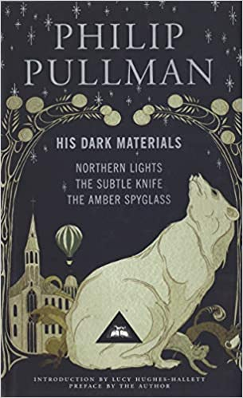
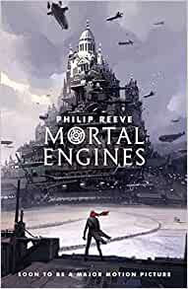
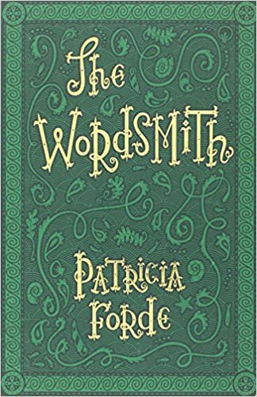
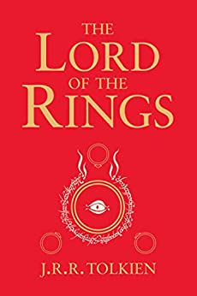
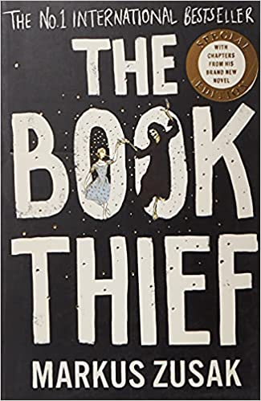
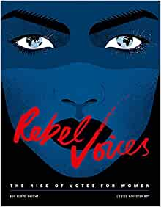
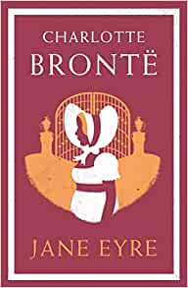
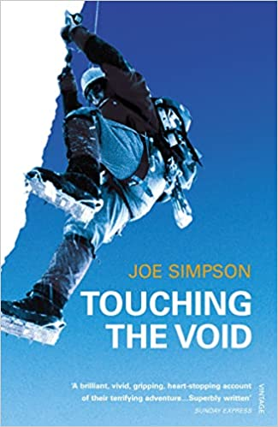
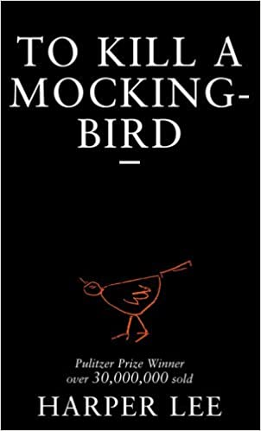
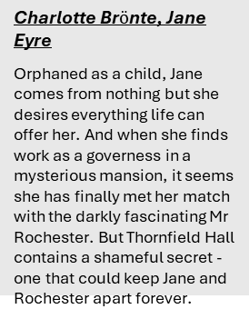
Sybil READS – KS3 Reading List
English
Phillip Pulman, His Dark Materials trilogy
A young girl is destined to liberate her world from the grip of the Magisterium which represses people's ties to magic and their animal spirits known as daemons. His Dark Materials is one of the supreme works of imaginative fiction for both children and adults published in the 20th century.
Phillip Reeve, Mortal Engines
In a dangerous future, huge motorized cities hunt, attack and fight each other for survival. As London pursues a small town, young apprentice Tom is flung out into the wastelands, where a terrifying cyborg begins to hunt him down.
Patricia Forde, Wordsmith
On the death of her master, Letta is suddenly promoted from apprentice to wordsmith, charged with collecting and archiving words in post-apocalyptic, neo-medieval Ark. When she uncovers a sinister plan to suppress language and rob the people of Ark of the power of speech, she realises that she has to save not only words, but the culture itself.
Home Region & Map Skills
J.R.R. Tolkien, Lord of the Rings
The future of civilization rests in the fate of the One Ring, which has been lost for centuries. Powerful forces are unrelenting in their search for it. But fate has placed it in the hands of a young Hobbit named Frodo Baggins (Elijah Wood), who inherits the Ring and steps into legend. A daunting task lies ahead for Frodo when he becomes the Ringbearer - to destroy the One Ring in the fires of Mount Doom where it was forged.
Eve Lloyd Knight, Rebel Voices: The Rise of Votes for Women
A stunning exploration of the brave campaigners all over the world who fought for women's right to vote. For centuries women have been confined to their homes destined for lives at home cleaning, cooking, caring for children or toiling in fields and factories.
The Book Thief, Mark Zusak
Liesel, a little girl who is taken to a new home because her mother can't afford to take care of her. The story is narrated by Death, who becomes a character you come to respect and even feel sympathise for by the end.
Charlotte Br$ö$nte, Jane Eyre
Orphaned as a child, Jane comes from nothing but she desires everything life can offer her. And when she finds work as a governess in a mysterious mansion, it seems she has finally met her match with the darkly fascinating Mr Rochester. But Thornfield Hall contains a shameful secret - one that could keep Jane and Rochester apart forever.
Joe Simpson, Touching the Void
The heart-stopping account of Joe Simpson's terrifying adventure in the Peruvian Andes. He and his climbing partner, Simon, reached the the summit of the remote Siula Grande in June 1995. A few days later, Simon staggered into Base Camp, exhausted and frost-bitten, with news that that Joe was dead.
Harper Lee, To Kill A Mockingbird
Many residents of Maycomb are racists and during the novel Atticus is asked to defend Tom Robinson, a black man wrongly accused of raping a white woman. Atticus takes on the case even though everyone knows he has little hope of winning.

Slide 3
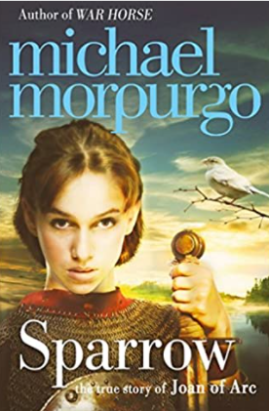
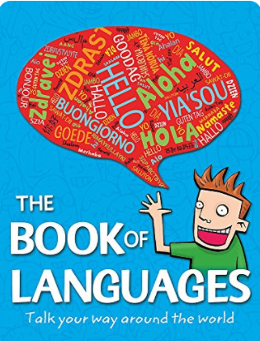
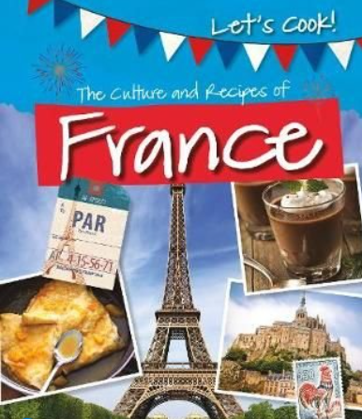
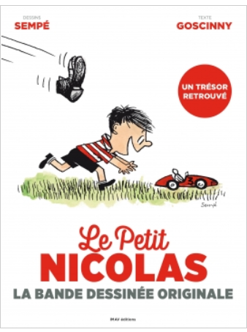
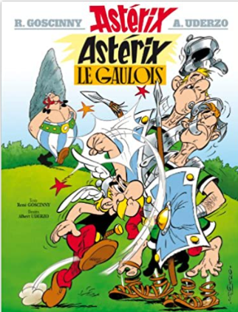

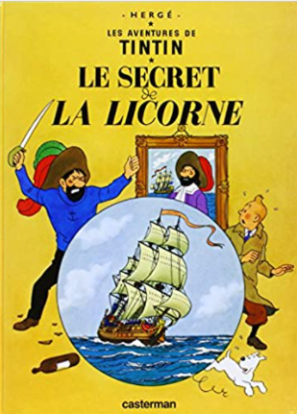
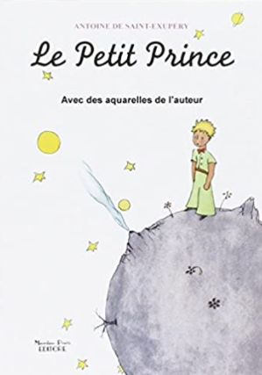
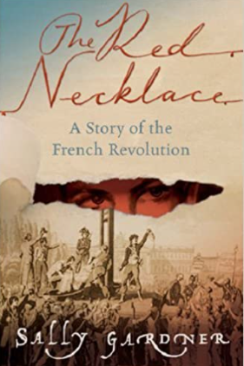
Sybil READS – KS3 Reading List
French/Languages
Morpurgo, Michael, Sparrow
Morpurgo’s researched interpretation of the life, incarceration and death of Joan of Arc. A great read for historical fans.
Webb, Mick,The book of languages – Talk your way around the world
Key facts and basic vocabulary for a number of the 7,000 languages spoken around the world. A great book to educate you about the many different world languages and their origins.
Kelly, Tracey, The culture and recipes of France
Explore the food and culture of France with instructions for ten recipes such as crêpes suzettes and potato gratin. The book also explores cultural aspects such as farming, festivals and daily life.
Home Region & Map Skills
Sempy et Goscinny, Le Petit Nicolas-la bande dessinée originale
A fun introduction to the French BD (bande dessinée comic strip). Read about the adventures of the cheeky and rather naughty Nicolas through the short and simple comic strip format.
1jour1actu
An on-line reading source of topical articles related to the French-speaking world.
www.1jour1actu.com
Goscinny, René, Astérix le Gaulois
The year is 50 BC and Gaul is occupied. Only one small village holds out against the invaders. But how much longer can Astérix, Obélix and their friends resist the power of the mighty Julius Caesar?
Hergé, Le secret de la licorne
When Tintin, a travelling reporter, stumbles across a model ship at the Old Street Market, he buys it as a gift for his friend Captain Haddock. But this isn’t just any old model ship . . . it’s the Unicorn which holds a clue to finding the treasure of a notorious pirate.
St Exupéry, Antoine, Le Petit Prince
After crash landing in the desert, a pilot encounters a little prince who is visiting earth from his own planet. Their conversations deal with the themes of loneliness, friendship, love and loss and is an observation on life and human nature.
Gardiner, Sally, The red necklace
In the late 18th century, Sido, the daughter of a marquis and Yann, a gypsy orphan, face a common enemy at the start of the French Revolution.

Slide 4
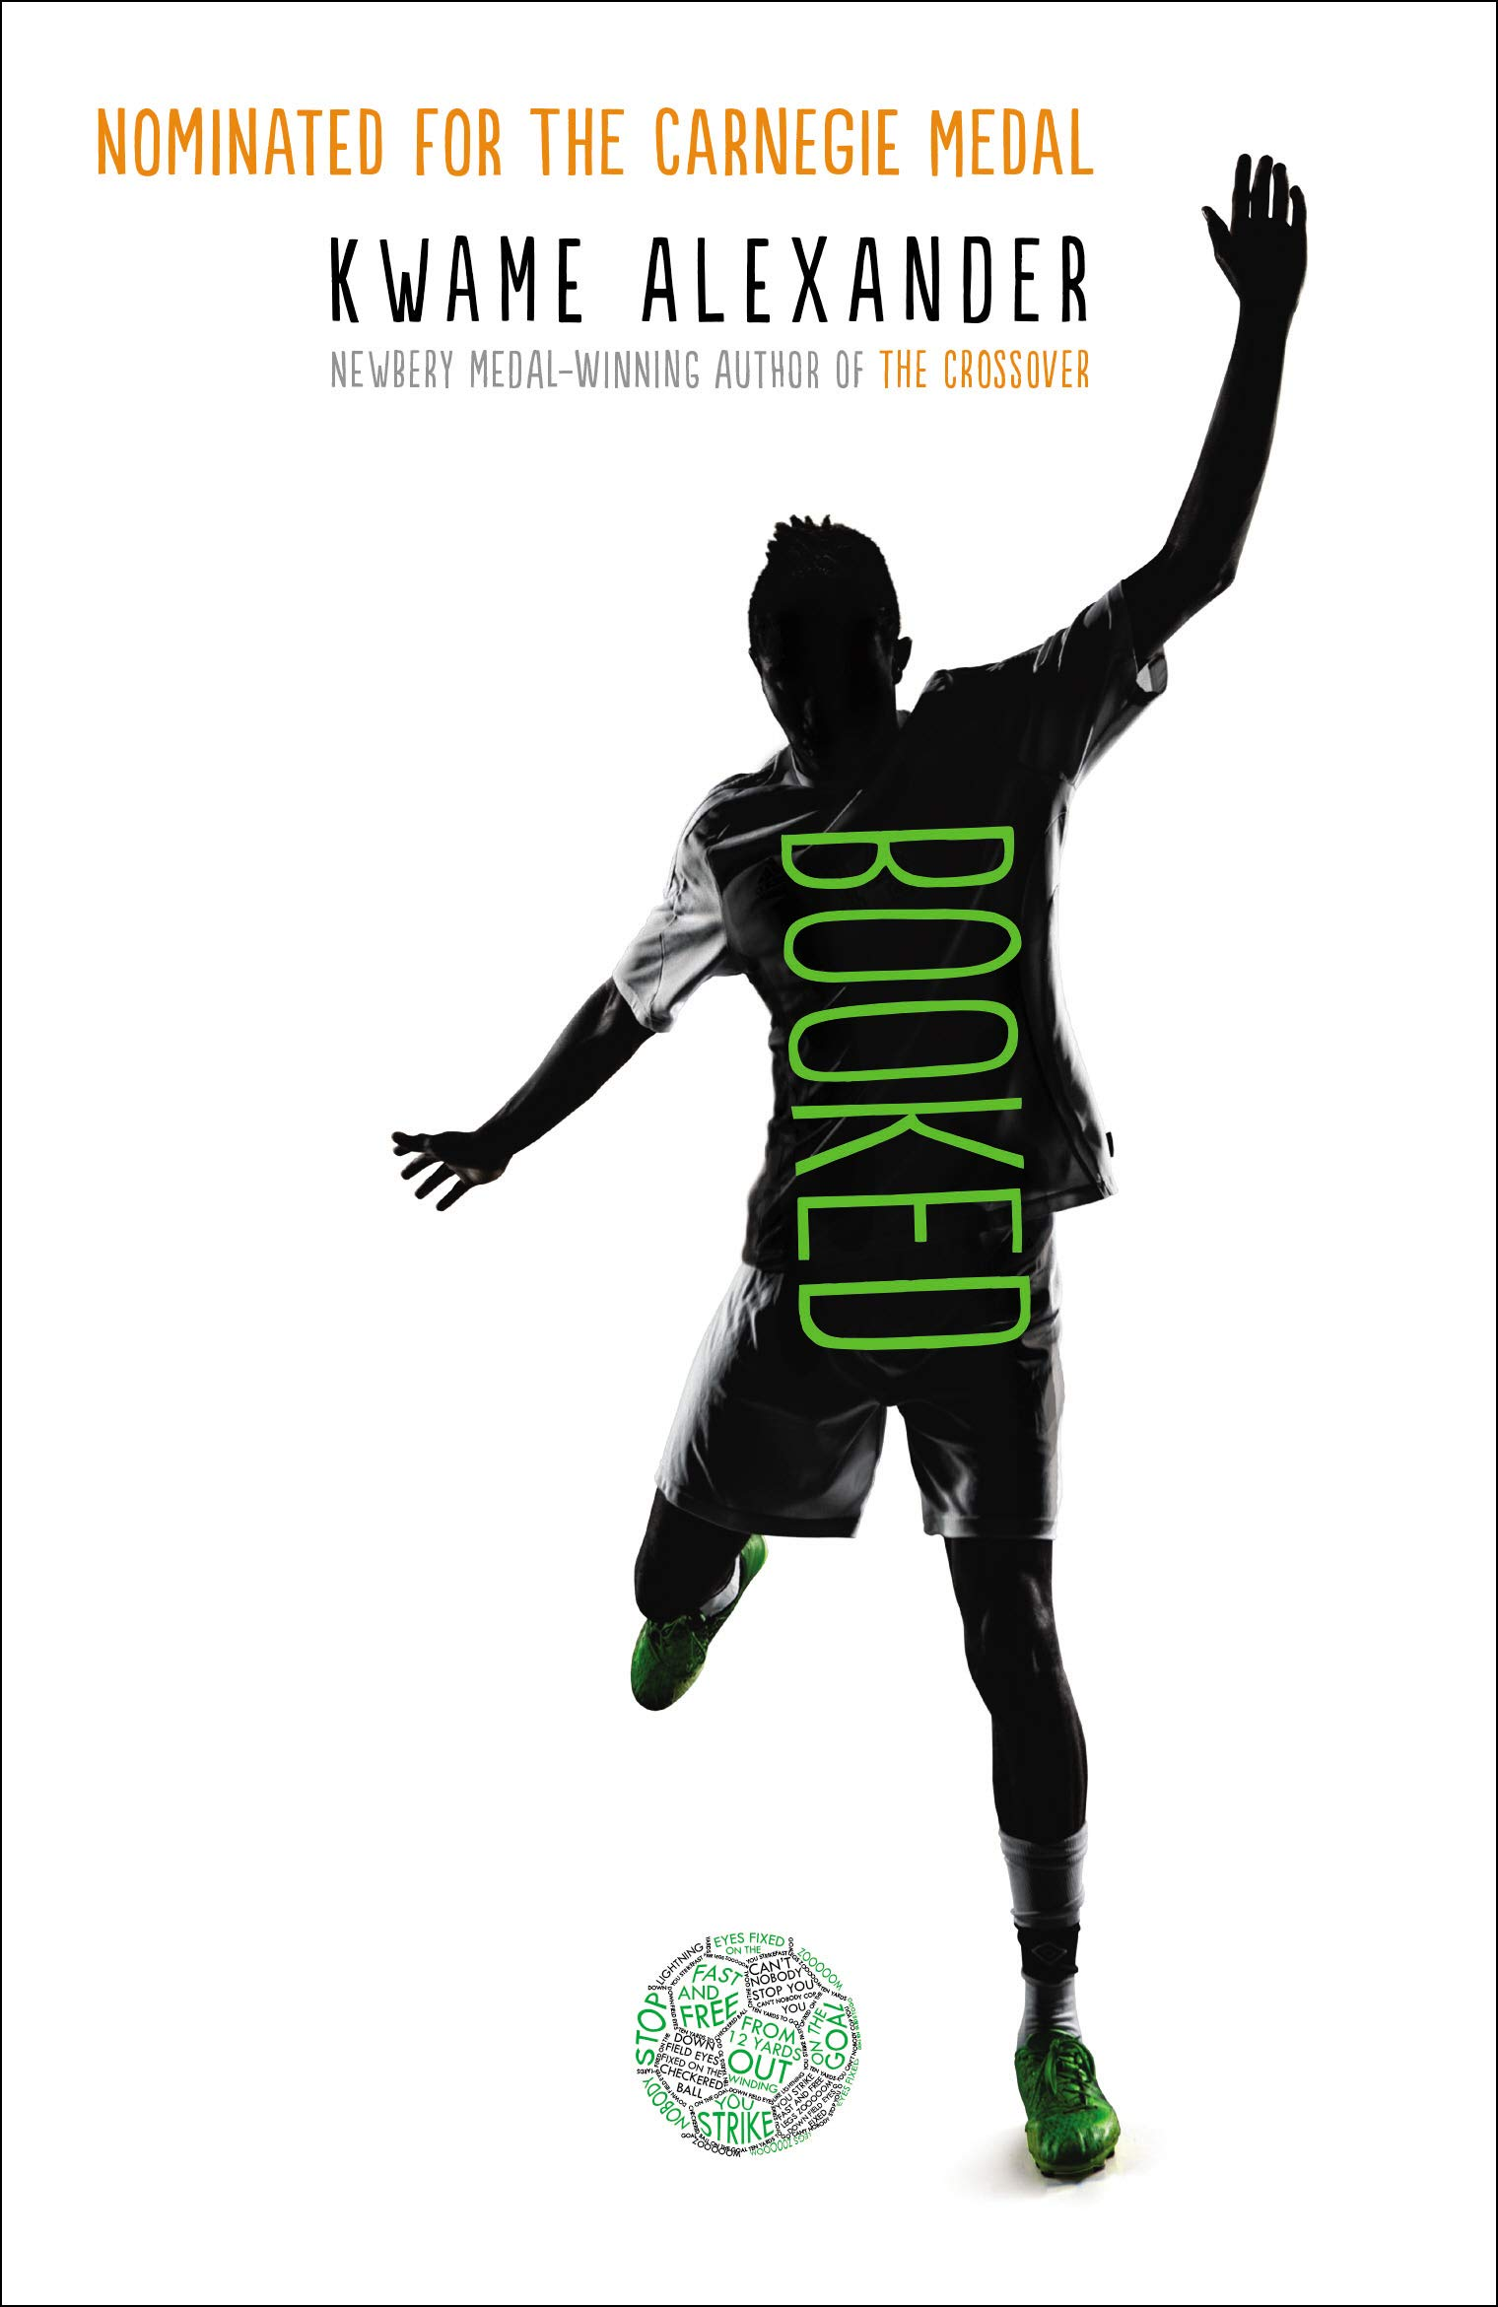
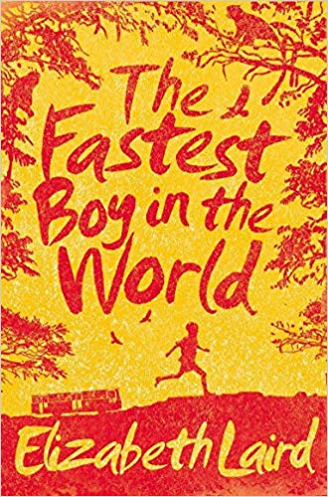
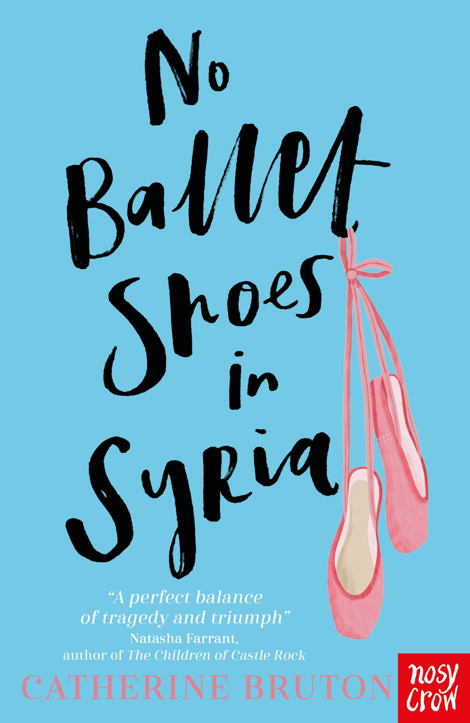
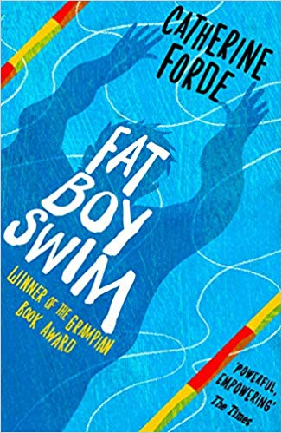
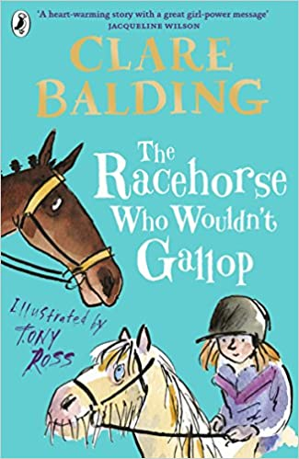
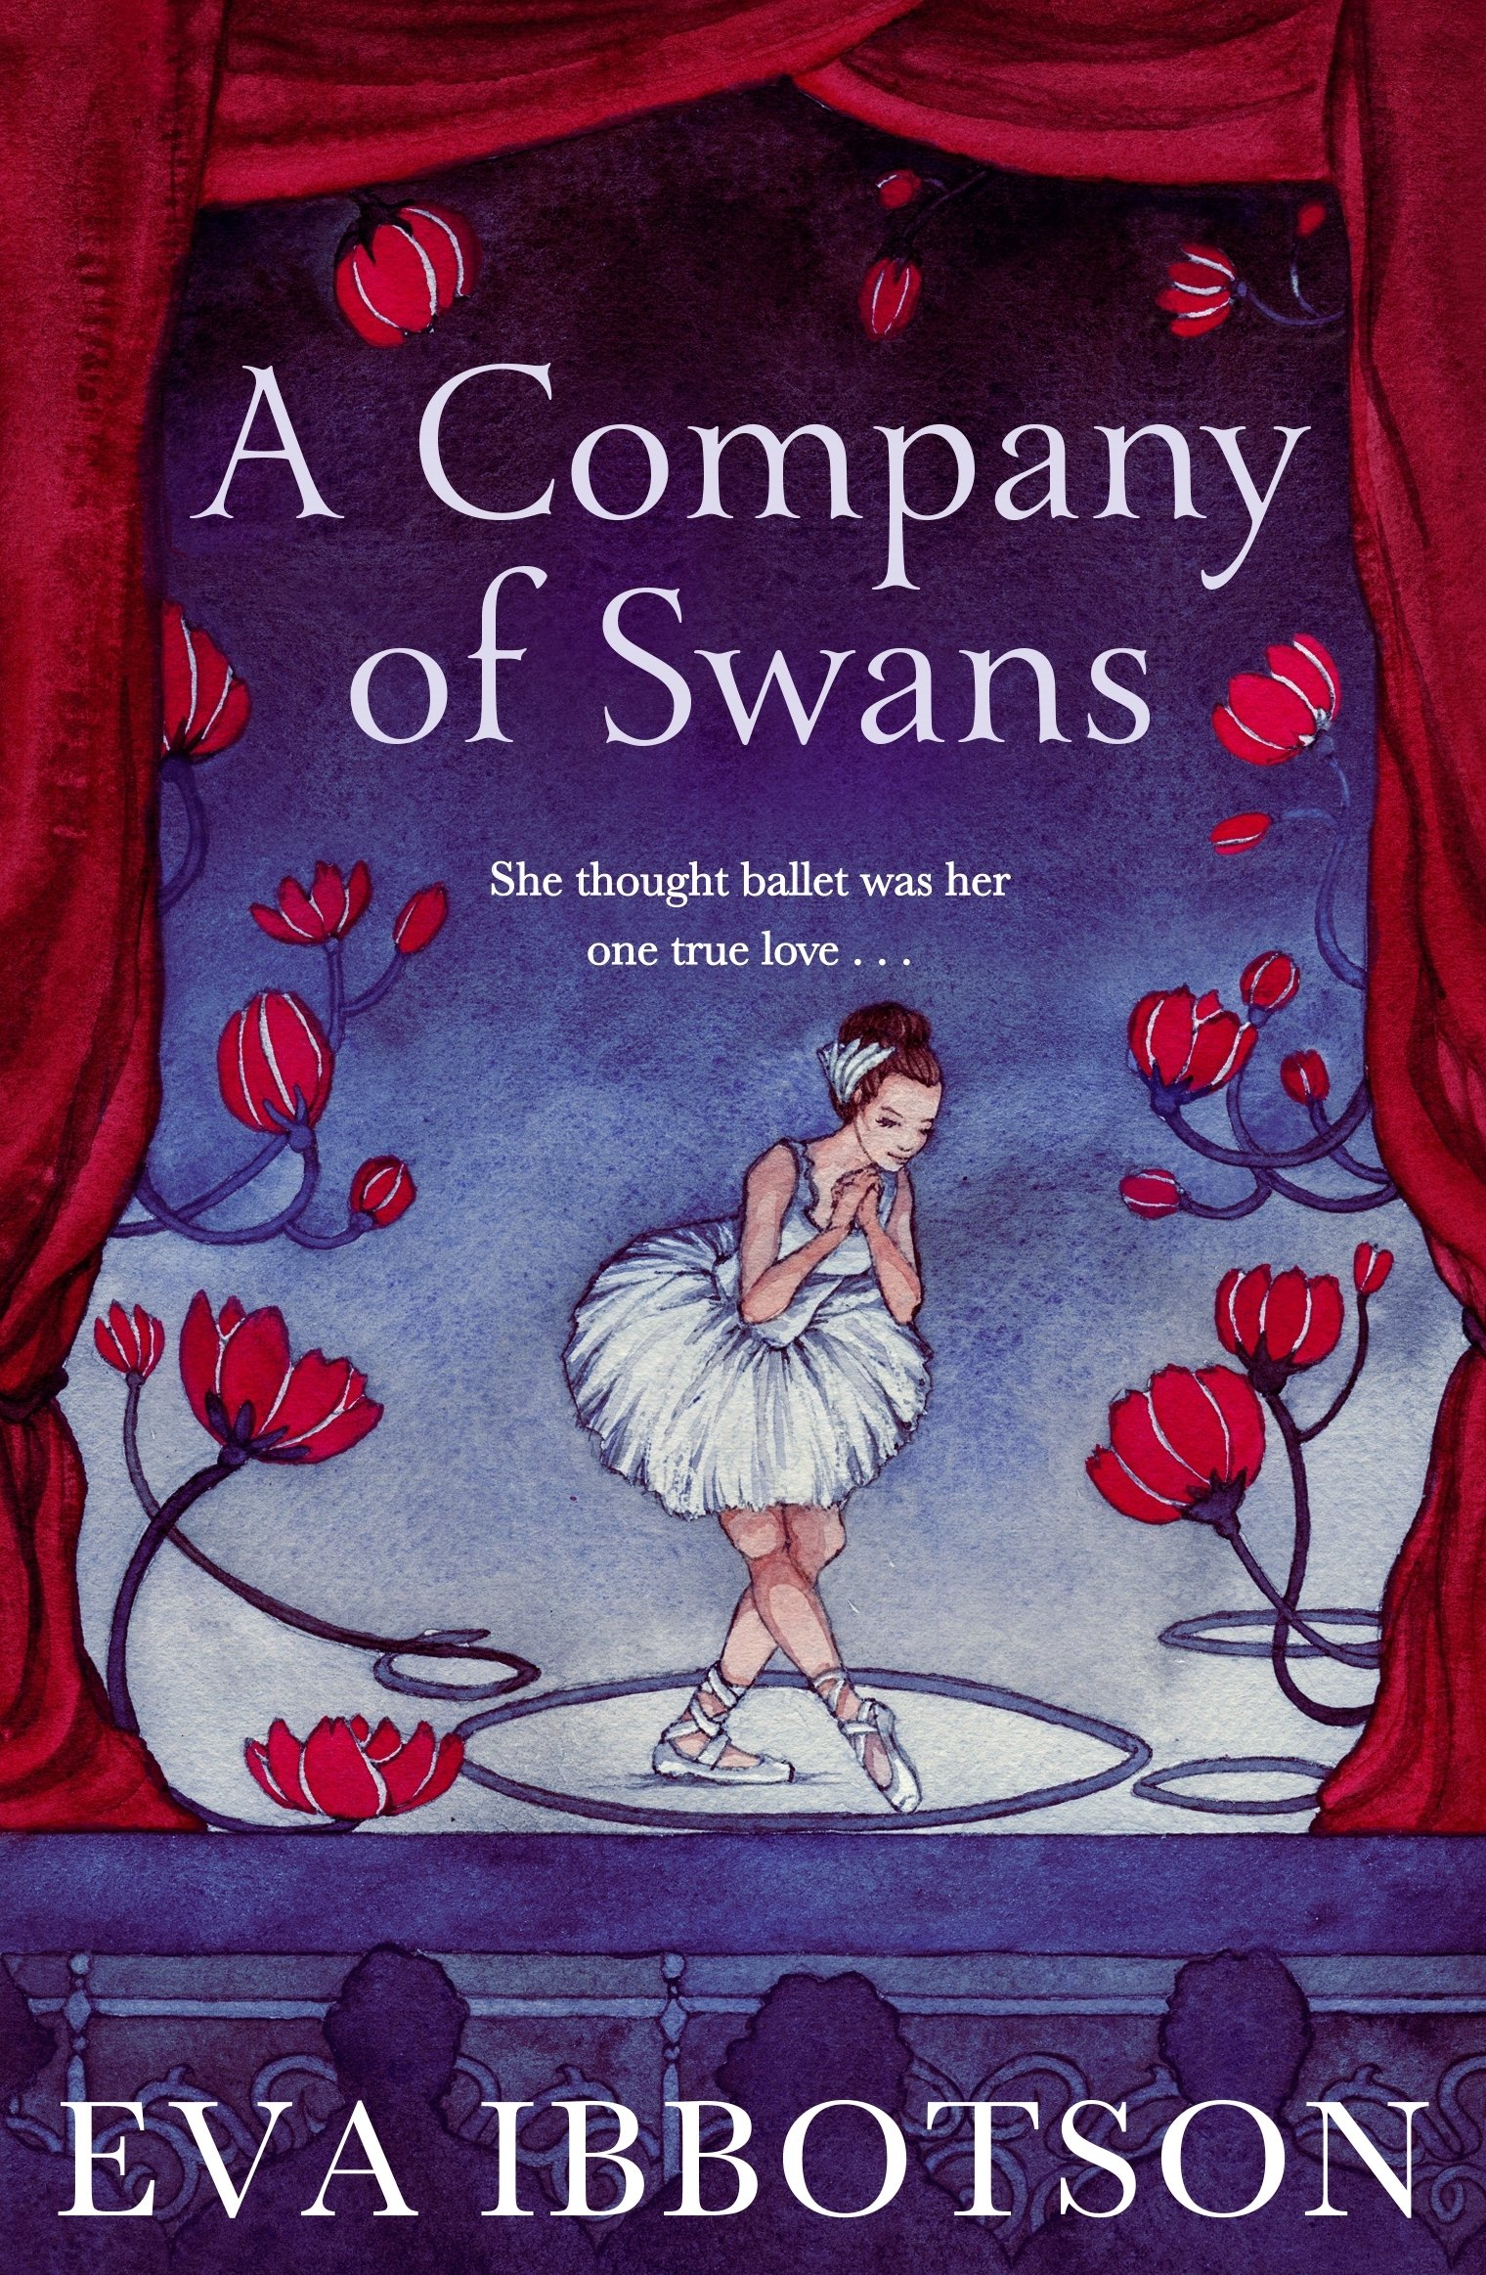
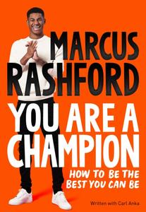
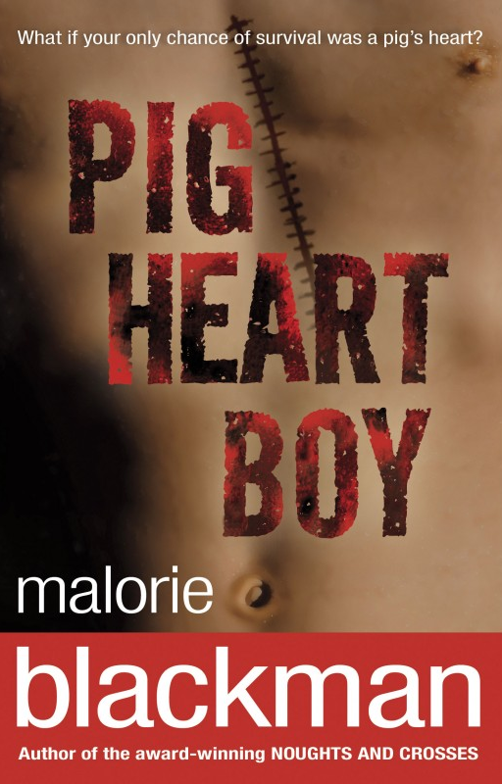
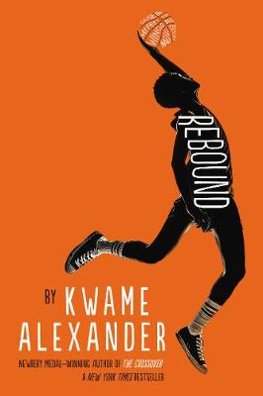
Sybil READS – KS3 Reading List
Physical Education
Kwame Alexander, Booked
Nick learns the power of words as he wrestles with problems at home, stands up to a bully, and tries to impress his dream girl. Helping him along are his friends and football mates, and The Mac, a rapping librarian
Elizabeth Laird, The Fastest Boy in the World
When Grandfather collapses following a long journey to Ethiopia's capital city, Solomon knows he has
to run the twenty
miles back home to
get his father.
Catherine Bruton, No Ballet Shoes in Syria
Aya has just arrived in Britain seeking asylum from war in Syria. When a dance teacher spots her talent, Aya has the potential to go to a ballet school. But will she be allowed to remain in the country?
Home Region & Map Skills
Catherine Forde, Fat Boy Swim
Teased for being grossly overweight, Jimmy, a fourteen-year-old teenager, who has a poor self-image, turns his life around by overcoming his fears and learning to swim. In the process he finds out the truth about his parents.
Clare Balding, The racehorse that would not gallop.
So when she accidentally manages to buy a racehorse, Charlie is thrilled. The horse she buys, Noble Warrior, looks the part: strong, fit and healthy. There's just one problem - he won't gallop.
Eva Ibbotson, A Company of Swans
Harriet Jane Morton's life changes drastically when chosen by a Russian ballet master to join his company. In the Amazon, she falls in love with a British exile with a mysterious past.
You are a champion. How to be the best you can be.
It's hard to know what’s possible until you start. You have been able to dream big and be prepared to work towards your dreams.
Malorie Blackman, Pig Heart boy
You're thirteen. All you want is a normal life. But most normal kids don't need heart transplants.
So there's this doctor. He says there's a chance for you. But he also says it's experimental, controversial and risky. And it's never been done before.
Kwame Alexander, Rebound After he gets into a spot of trouble, his mum decides to send him to spend the summer with his paternal grandparents a few hours drive away. Here, his cousin Roxie introduces him to basketball, his grandad introduces him to hard work and jazz, and things begin to change.

Slide 5
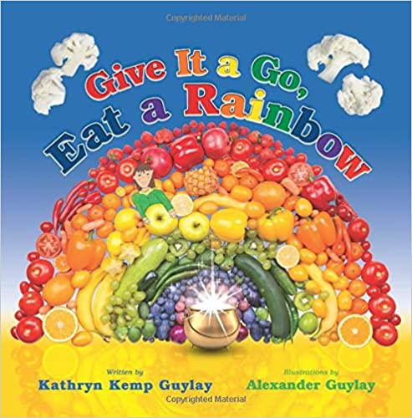
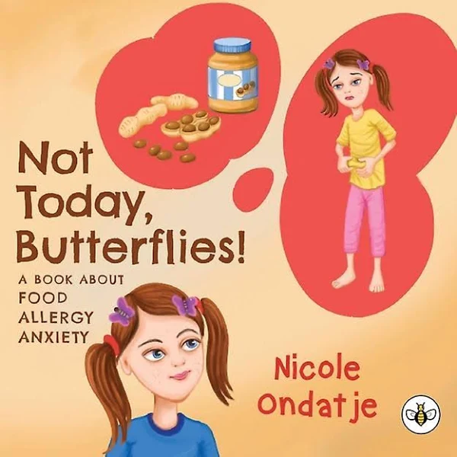
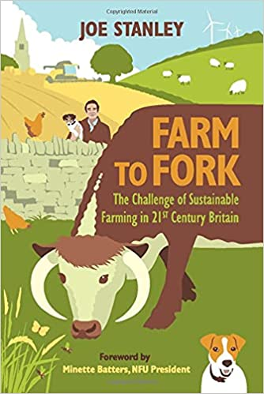
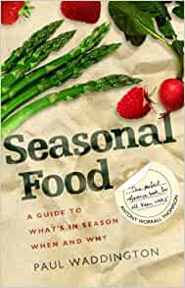
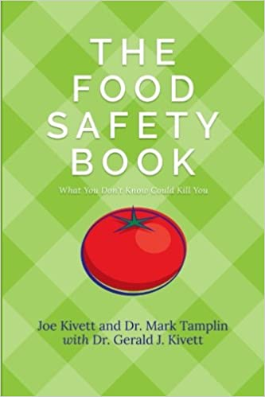
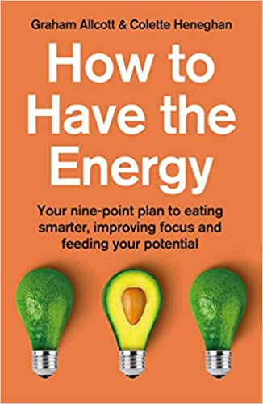
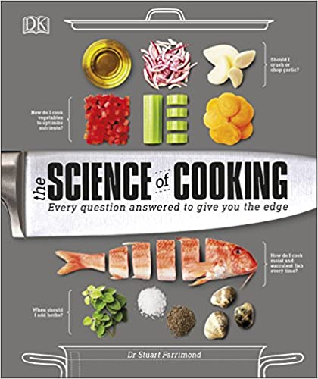
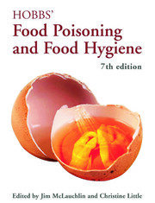
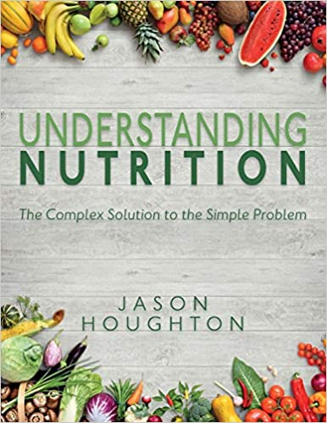
Sybil READS – KS3 Reading List
Food and Nutrition
Give It a Go, Eat a Rainbow
You are introduced to Blake, the main character, who feels sleepy (low energy) and wonders why he doesn’t have the energy to play like other kids. Blake meets a friendly, magical leprechaun who takes Blake on a journey to find the pot of gold (a metaphor for good health and energy).
Not Today, Butterflies! A Book About Food Allergy Anxiety
A Book About Food Allergy Anxiety provides an engaging and relatable experience for children who are coping with fears and anxiety about their own food allergies.
Farm to Fork: The Challenge of Sustainable Farming in 21st Century Britain
In this book, Joe Stanley informs the reader about the journey their food takes before it gets to the plate, revealing the realities of modern agricultural life for a British lowland farmer.
Home Region & Map Skills
Seasonal Food: A guide to what's in season when and why
The book is organized into twelve chapters, one for each month of the year. Each chapter starts with a brief story about the month itself, followed by narrative sections covering what's in prime season.
The Food Safety Book: What You Don't Know Could Kill You
THE FOOD SAFETY BOOK is a consumer's guide that answers just about every food safety, quality, and food storage-related question anyone might have.
How to Have the Energy: Your nine-point plan to eating smarter, improving focus and feeding your potential
This book explains how to have the energy, explaining how not only what, but how you eat can improve your focus, boost productivity and even give you more time in your day.
The Science of Cooking: Every Question Answered to Perfect your Cooking
Why does chocolate taste so good? Is it OK to reheat cooked rice? How do I cook the perfect steak or make succulent fish every time? Perfect your cooking with practical instruction - and the science behind it.
Understanding Nutrition: The Complex Solution to the Simple Problem
A great introduction to health and nutrition and Ideal for anyone interested in learning about the basic components of food, health and disease, along with the newer topics of gut bacteria and probiotics.
Hobbs' Food Poisoning and Food Hygiene
This unique textbook takes a holistic approach to food poisoning and food hygiene, explaining in clear and non-technical language the causes of food poisoning with practical examples from 'real-life' outbreaks.

Slide 6
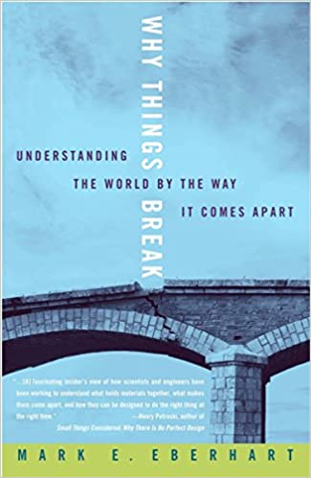
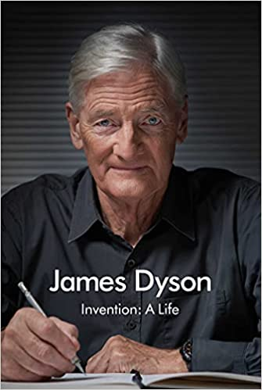
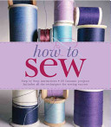
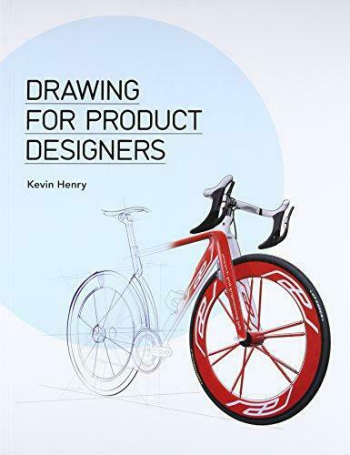





Sybil READS – KS3 Reading List
Design Technology & Textiles
Why Things Break: Understanding the World By the Way It Comes Apart
Why Things Break explores the fascinating question of what holds things together (for a while), what breaks them apart, and why the answers have a direct bearing on our everyday lives.
Invention: A Life
In Invention: A Life, James Dyson reveals how he came to set up his own company and led it to become one of the most inventive technology companies in the world. For, as he says, 'everything changes all the time, so experience is of little use'.
How to Sew
How to sew shows you how to make simple garments and home accessories and turn them into something unique by using a mixture of vintage, modern and traditional fabrics.
Home Region & Map Skills
Drawing for Product Designers
This is a practical guide to both hand- and computer-drawn design. Readers will learn to think three-dimensionally and build complex design ideas that are structurally sound and visually clear.
Made to Measure New Materials for the 21st Century
This book looks at thousands of new materials, ranging from synthetic skin, blood, and bone to substances that repair themselves and adapt to their environment, that swell and flex like muscles, that repel any ink or paint, and that capture and store the energy of the Sun.
Textile Nature: Embroidery Techniques Inspired by the Natural World
This guide demonstrates how to get the most out of your surroundings to create original and unique pieces in textiles.
Make: Electronics: Learning Through Discovery
In this book you will see how components work--and what happens when they don't. You'll short out a battery and overheat an LED. You'll also open up a potentiometer and a relay to see what's inside
Sustainable Energy - Without the Hot Air
This book organises a plan for change on both a personal level and an international scale. It answers questions surrounding nuclear energy, the potential of sustainable fossil fuels, and the possibilities of sharing renewable power.
Fundamentals of Natural Fibres and Textiles
This book explains the characteristics of natural fibres, looks at the environmental impact of the processing of fibres
Provides the latest updates on technologies for designing.

Slide 7









Sybil READS – KS3 Reading List
Geography
Time Travelling with a Hamster
On Al Chaudhury’s twelfth birthday his beloved Grandpa Byron gives him a letter from Al’s late father. In it Al receives a mission: travel back to 1984 in a secret time machine and save his father’s life.
Boy in the Tower
Ade loves living at the top of a tower block. From his window, he feels like he can see the whole world stretching out beneath him.
His mum doesn't really like looking outside - but it's going outside that she hates. She prefers to sleep all day inside their tower, where it's safe.
Where The World Ends
Every summer Quill and his friends are put ashore on a remote sea stac to hunt birds. But this summer, no one arrives to take them home. Surely nothing but the end of the world can explain why they've been abandoned - cold, starving and clinging to life, in the grip of a murderous ocean. How will they survive
Letters to the Earth
Is the beginning of a new conversation. One that attempts to answer some of these questions by listening to the voices of parents and children; politicians and poets; songwriters and scientists.
Home Region & Map Skills
The Silk Roads: A New History of the World:
For centuries, fame and fortune were to be found in the west – in the New World of the Americas. Today, it is the east which calls out to those in search of riches and adventure. Sweeping right across Central Asia and deep into China and India, a region that once took centre stage is again rising to dominate global politics, commerce and culture
Blue Planet II
Our understanding of ocean life has changed dramatically in the last decade, with new species, new behaviours, and new habitats being discovered at a rapid rate.
Population 10 Billion
Are there too many people on the planet? Is this the end of life as we know it? Distinguished geographer Professor Danny Dorling thinks we should not worry so much and that, whatever impending doom may be around the corner, we will deal with it when it comes. In a series of fascinating chapters he charts the rise of the human race from its origins to its end-point of population 10 billion
Prisoners of Geography
All leaders are constrained by geography. Their choices are limited by mountains, rivers, seas and concrete. Yes, to follow world events you need to understand people, ideas and movements - but if you don't know geography, you'll never have the full picture.
This is the Way the World Ends
Jeff Nesbit has delivered an enlightening - and alarming - explanation of the climate challenge as it exists today. Climate change is no far-off threat. It's impacting communities all over the world at this very moment, and we ignore the scientific reality at our own peril.

Slide 8









Sybil READS – KS3 Reading List
Art & Design
Art Class
Art Class is an easy-to-use manual covering everything the beginner needs to know to get started: the basics of drawing, oil, and water colour painting, composition, and perspective.
The Day of the Dead: A Visual Compendium
This anthology considers how the Day of the Dead has been celebrated in visual art and culture, from the traditional and iconic illustrations of Manuel Manilla and José Posada to the paper cuts of Aaron Velasco Pacheco
How to Give Up Plastic: A Guide to Changing the World, One Plastic Bottle at a Time.
This guide will help you make the small changes that make a big difference, from buying a reusable coffee cup to running a clean-up at your local park or beach.
Home Region & Map Skills
My book of birds
Full of stunning illustrations and incredible facts, My Book of Birds is a glorious celebration of birds.
Food in art
In this richly illustrated book, Gillian Riley provides fresh insight into how the relationship between humans and food has been portrayed in art from ancient times to the Renaissance.
On the Curve: The Life and Art of Sybil Andrews
Although she was raised in Bury St Edmunds, England, On the Curve focuses on Andrews' life after she immigrated to Canada in 1947.
The Art of Still Life: A Contemporary Guide to Classical Techniques, Composition, Drawing, and Painting in Oil
This book provides the foundation basics and advanced techniques you need for successful drawing and painting.
How to Draw The Human Figure
This book helps you to learn how to draw the human body in various sitting, standing and active positions
Understanding Nutrition: The Complex Solution to the Simple Problem
Beginning in the early 20th century Paris, the movement presented the world in a fresh, experimental, and challenging new way, merging viewpoints and celebrating the geometric.

Slide 9








Sybil READS – KS3 Reading List
Science
Madeleine L’engle, A Wrinkle in Time
Adventures in space and time of Meg, Charles Wallace, and Calvin O'Keefe. They are in search of Meg's father, a scientist who disappeared while engaged in secret work for the government on the tesseract problem.
Alison Prince, Speed
Deb's biker boyfriend likes to live - and drive - dangerously. She's hooked on the thrill of speed - but how long before her luck runs out?
Catherine Fisher, At the worlds end.
Caz hasn't been outside in nine years, not since a poisonous star locked the world in ice and destroyed all life. One small pocket of humanity survived, but food is running short and tensions are running high. Caz takes her chances outside, along with her friend Will, hoping against hope that they're not the last ones left.
Rosanne Parry, A Wolf Called Wander
Swift, a young wolf cub, lives with his pack in the mountains. Then a rival pack attacks, and Swift and his family scatter. Alone and scared, Swift must flee and find a new home. His journey takes him a remarkable one thousand miles across the Pacific Northwest.
Home Region & Map Skills
Sarah Crossan, Breathe
Ever since the Switch, when the oxygen levels plummeted and most of humanity died, the survivors have been protected in glass domes full of manufactured air. Protected . . . or trapped? Or controlled?
Simon Mayo, Itch
Fourteen-year-old Itchingham Lofte, nicknamed Itch, has an unusual passion: collecting specimens of every element in the periodic table. So what if that means he's had a few ... mishaps? But when he gets his hands on a suspiciously warm rock made of a new, previously unknown element, things really begin to explode.
Philip Reeve, Mortal Engines
In a future land once known as Britain, nomad tribes are preparing to fight a terrifying enemy - the first-ever mobile city. Before London can launch itself, young engineer Fever Crumb journeys to the wastelands of the North to seek out the ancient birthplace of the Scriven mutants.
Malcolm Rose, Four degrees more
This thriller about global warming opens with teenage Leyton watching his bedroom collapse into the sea as a result of climate change and rising sea levels. He is soon caught up in a maelstrom of environmental campaigns and industry counter-plots, some of which turn out to be rather more sinister than he had bargained for.
Malorie Blackman, Pig Heart Boy
You're thirteen. All you want is a normal life. But most normal kids don't need heart transplants.
So there's this doctor. He says there's a chance for you. But he also says it's experimental, controversial and risky. And it's never been done before.

Slide 10









Sybil READS – KS3 Reading List
RPE
Life of Pi
After the tragic sinking of a ship, Pi, a hyena, a zebra (with a broken leg), a female orang-utan - and a 450-pound Royal Bengal tiger. The scene is set for one of the most extraordinary and best-loved works of fiction in recent years.
I am Malala
When the Taliban took control of the Swat Valley, one girl fought for her right to an education. I Am Malala will make you believe in the power of one person's voice to inspire change in the world.
Can a Robot be Human
The book introduces some of life's most important questions with tales stories, reasons and arguments, common sense and bizarre conclusions. This book gives rise to some of the most exciting problems in philosophy - from logic to ethics.
Home Region & Map Skills
Wonder
Starting 5th grade at Beecher Prep, Auggie wants nothing more than to be treated as an ordinary kid—but his new classmates can’t get past his extraordinary face. The book considers ideas of identity, prejudice, discrimination, stereotypes and community.
The Boy In The Striped Pyjamas
Intensely haunting and emotionally devastating, Boyne’s delicate fable takes a child’s eye view of twentieth century history and finds resonances lacking from many adult accounts.
The Philosopher Queens
This book is a about the lives and works of women in philosophy by women in philosophy. This collection brings to centre stage twenty prominent women whose ideas have had a profound – but some uncredited - impact on the world.
Philosophy for Beginners
Philosophy is a way of thinking about just about anything. It asks big questions, such as "how can I be good?" or "what makes something beautiful?" Using lively examples, humorous illustrations and simple thought experiments, this book opens up the world of philosophy to children and adults with enquiring minds.
How the World Thinks
A ground-breaking survey of the philosophies of the world, their origin and their relevance to twenty-first century life. Illustrating the great Eastern systems of thought with clarity and concision, How the World Thinks is a triumph of comparative philosophy.
Does My Head Look Big In This?
Amal is a 16-year-old Melbourne teen with all the usual obsessions about boys, chocolate and Cosmo magazine. She's also a Muslim, struggling to honour the Islamic faith in a society that doesn't understand it.

Slide 11









Sybil READS – KS3 Reading List
Maths
L'Engle, Madeleine, A Wrinkle in Time
Adventures in space and time of Meg, Charles Wallace, and Calvin O'Keefe. They are in search of Meg's father, a scientist who disappeared while engaged in secret work for the government on the tesseract problem.
Christopher Edge, The Jamie Drake Equation (BL 6.4)
Jamie's dad is orbiting Earth in the International Space Station, and Jamie misses him. At his local observatory, he picks up a signal on his phone. Can Jamie help his dad when his mission goes wrong?
C S Lewis, Alice in Wonderland (BL 7.4)
Proportions, algebra and geometry: when Alice follows the White Rabbit down a rabbit hole, she finds herself in an enchanted world, filled with creatures and madness. Alice quickly finds out that nothing is as it seems in Wonderland…
…
Home Region & Map Skills
Holly Smale, Geek Girl (4.4)
Harriet Manners knows a lot of things, but she doesn't know why nobody at school seems to like her. So when she's offered the chance to reinvent herself, she grabs the chance. Can she transform from geek to chic?
Wendy Lichtman, Secrets, Lies and Algebra
Tess loves math because it's the one subject she can trust—there's always just one right answer. But then she starts algebra and is introduced to those pesky and mysterious variables, which seem to be everywhere in eighth grade.
Hans Enzensberger, The Number Devil (BL 4.4)
Robert, a boy who hates math, meets a Number Devil, who leads him to discover the amazing world of numbers: infinite numbers, prime numbers, Fibonacci numbers, numbers that magically appear in triangles…
Mark Haddon, The Curious Incident of the Dog in the Night Time(BL5.4)
A story told through Christopher’s eyes: an autistic boy gifted with numbers. Contains mathematical theorems and lots of prime numbers!
NOTE: The book version contains very strong language- the playscript is more suitable.
Tom Pollock, White Rabbit, Red Wolf (BL5.2)
Pete is a maths prodigy who suffers from severe panic attacks. Dragged into a world of espionage after his mother is stabbed and his twin sister goes missing, will Pete's skills and instincts save him? Warning: contains extreme violence.
John Green, An Abundance of Katherines (BL 5.6)
Colin is on a mission to prove The Theorem of Underlying Katherine Predictability, which he hopes will predict the future of any relationship, avenge Dumpees everywhere, and finally win him the girl. NOTE:
Contains mature themes

Slide 12









Sybil READS – KS3 Reading List
PSHEE
Be Yourself Poppy O’Neill This practical guide combines proven cognitive behavioural therapy and mindfulness methods used by child psychologists in schools with simple activities to help your child to build on their self-belief. It’s aimed at children aged 7–11 because a lot happens in these years that can impact a child’s emotional well-being, not just now but for years to come.
Me & my Feelings, Vanessa Green Allen, Sometimes, emotions like anger or jealousy or excitement can seem too big to keep inside. Me and My Feelings is here to tell you: It's okay to have big feelings. And the good news is, you can calm down those strong emotions―so you won't feel like you're going to explode
Packed with honest advice on managing Aunt Flo like a boss, WELCOME TO YOUR PERIOD inducts pre-teens into the secret society of menstruation: from demystifying what cramps feel like, to whether you can feel it coming out, to what you should do if your pad leaks on to your dress. With equal measures of warm, big-sisterish wisdom and medical myth-busting, there are tons of case studies, first-person accounts and questions, making it the must-have book for every pre-teen.
Home Region & Map Skills
Anger is a normal emotion just like joy, sadness, and fear, but it can be difficult to know how to express those feelings in a good way. The Anger Management Workbook for Kids is filled with 50 playful exercises to help you handle powerful emotions. You can stay calm and make better choices when you feel angry. Other workbooks about anger management for kids ages 6-12 wish they could be this fun!
I'm no good at sport ... I can't do maths ... I really struggle with exams ... Sound familiar?
If you believe you can't do something, the chances are you won't try. But what if you really could get better at maths, or sport or exams? In fact, what if you could excel at anything you put your mind to?
Mindful affirmations, Pragya Tomar Growing up can be a difficult time for kids, especially when they need to deal with emotions like anxiety, sadness, and stress, but this inspiring book seeks to help them on their journey of self-discovery, providing them a safe and enjoyable place to doodle, colour, journal, vent, and let go of their worries.
Nicola Morgan, The awesome power of sleep Late nights, addictive technology and minds racing with exam stress and friendship worries: it's no wonder the teenage stereotype is tired eyes and sleeping through the weekend. Just like adults, teenagers are sleeping less now than ever before, yet sleep is crucial to our health and well-being.
Nicola Morgan, Positively TeenageThe media so often portray adolescence negatively but this book shows you how to approach these years far more positively so that you can really flourish and be in control. You'll find simple strategies to develop a positive attitude, growth mindset, self-understanding, determination and resilience and you'll see how those strengths will help you cope with any challenges, enjoy life and achieve your potential.
This growth mindset inspired journal is designed to encourage boys and girls with developing their self-confidence and positivity.
The Happy Mindset Little Journal includes inspirational activities, quotes, inquisitive questions, creative illustrations, and writing prompts.

Slide 13









Sybil READS – KS3 Reading List
Performing Arts
Nick Hornby, High Fidelity
Rob Fleming is a 35-year-old man who owns a record shop called Championship Vinyl. He's going through a crisis. At his record shop him they spend their free moments discussing mixtapes and creating top five lists of anything that demonstrates their knowledge of music, movies, and pop culture.
Roddy Doyle, The Commitments
Two friends — Derek Scully and "Outspan" Foster — get together to form a band, but soon realise that they don't know enough about the music business to get much further than their small neighbourhood in the Northside of Dublin.
Jeremy McCarter, Hamilton: The Revolution
Lin-Manuel Miranda's groundbreaking musical Hamilton is as revolutionary as its subject, the poor kid from the Caribbean who fought the British, defended the Constitution, and helped to found the United States.
Home Region & Map Skills
Jenifer Egan, A Visit from the Goon Squad
A series of interlocking stories tell the tale of ageing former punk rocker-turned-record executive, Bennie Salazar, and Sasha, the troubled young woman who works for him. A truly rollicking read!
Michael Chabon, Telegraph Avenue.
Best friends, bandmates and second-hand record store co-owners Archy and Nat face tough times when a new megastore threatens their independent business. This epic American novel tells the stories of two families and their struggles in a multicultural community, to a vibrant soul-jazz beat.
Mark Haddon, The Curious Incident of the Dog in the Night-Time
Christopher is fifteen and has Asperger's Syndrome. He hates the colours yellow and brown. He has never gone further than the end of the road on his own, but when he finds a neighbour's dog murdered he sets out on a terrifying journey which will turn his whole world upside down.
Catlin Moran, How To Be Famous
Johanna is 19 and living in London at the height of Britpop in 1995. She’s got a new column in The Face to talk about fame and all its highs and lows – but soon finds herself a target of unwelcome attention after a disastrous encounter with an infamous comedian.
Val Emmich, Dear Evan Hansen
When a letter that was never meant to be seen draws high school senior Evan Hansen into the Murphy family's grief over the loss of their son, he is given the chance of a lifetime: to belong.
Simon Spence, The Stone Roses: War and Peace
From the Manchester backwaters to the worldwide 2012 tour, War and Peace lays bare the irresistible tale of the last of the great bands. War and Peace traces the band's genesis,. The Roses' legendary gigs culminated in the era-defining Spike Island show in 1990.

